Slide 1

Maximize your giving
3483615.5

Slide 2
Disclosure/Disclaimer
Thrivent Charitable Impact & Investing® is a public charity that serves individuals, organizations and the community through charitable planning, donor-advised funds and endowments. Thrivent Charitable Impact & Investing works collaboratively with Thrivent and its financial advisors. It is a separate legal entity from Thrivent, the marketing name for Thrivent Financial for Lutherans.
Insurance products, securities and investment advisory services are provided by appropriately appointed and licensed financial advisors and professionals. Only individuals who are financial advisors are credentialed to provide investment advisory services. Visit Thrivent.com or FINRA’s Broker Check for more information about Thrivent’s financial advisors.
Donors must itemize deductions to receive a charitable income tax deduction. Charitable giving can result in tax, legal and financial consequences. Thrivent, its financial professionals, and Thrivent Charitable Impact & Investing ®, do not provide legal, accounting, or tax advice. Consult your attorney or tax professional.
To ensure compliance with IRS requirements, be aware that any U.S. federal tax advice that may be contained in this presentation is not intended to be used, and cannot be used, for the purpose of (i) avoiding penalties under the Internal Revenue Code or (ii) promoting, marketing and recommending another party to any transaction or matter addressed herein.
Thrivent and its financial advisors and professionals do not provide legal, accounting or tax advice. Consult your attorney or tax professional.
The donor’s experience may not be the same as other donors and does not indicate future performance or success.

Slide 3
Agenda
01
Expressing your generosity
02
Charitable funds
03
Giving options
04
Putting it together
Notes:
Today, you’ll hear how our giving expresses our values and priorities. You’ll also hear examples of how to make your giving last well into the future.

Slide 4

Expressing your generosity

Slide 5



Expressing your generosity
Spontaneous giving
Intentional giving
Planned giving
Notes:
Spontaneous giving is typically spur of the moment and donations are smaller. Examples include disaster relief efforts and neighbors in need.
Intentional giving includes donations made on a regular basis. Examples include giving to your church or other favorite charities monthly or yearly.
Planned giving is part of an overall financial strategy. This is where a qualified professional can help you develop a giving plan designed to match your charitable interests and financial circumstances. This kind of generosity can be implemented while living or after death.

Slide 6

Poll: Do you have a formalized, written charitable giving plan in place?
Yes
No
Notes:
Let’s start with a poll. Do you have a formalized written, charitable giving plan in place.

Slide 7

Charitable funds
Notes:
You are not alone if you don’t have a formal plan in place. Many don’t know what one is or how to get started. Today, we’ll talk about the elements of a charitable plan and how you can be even more intentional and strategic with your giving.

Slide 8



What is a charitable fund and how does it work?
Give
Give Now. Give Later. Give & Receive™.
Grow
Charitable fund
Grant
Distributions
Contribute assets into your fund.
Choose an investment option to match your goals.
Distribute to support organizations and causes closest to your heart.
Notes:
Let’s start with a charitable fund – what is it and how does it work?
A charitable fund is a financial tool and one of the ways to help you think differently on how to formalize your charitable giving plans and live your values.
The funds contributes are invested and may grow until you are ready to make grants to the organizations or causes you care about most.
There are several reasons for start a charitable fund. From a practical point of view, you can centralized your giving – meaning come tax time, you will receive one receipt and not need to gather from several sources. Another is you can give to your fund and potentially receive the tax credit in the year it was given without needing to immediately give out to a charity. This can help with budgeting and being more planful in how you want to support the causes and charities that matter most to you.

Slide 9

Ways to give
Notes:
How do you give to a charitable fund? We have a full range of giving options for individuals and organizations that can be tailored to specific financial circumstances. You may receive tax benefits based on when and how your gifts are made.

Slide 10
Categories of Giving to a Charitable Fund
There are three common ways to give charitably.
Each of these giving methods may benefit your charitable fund.
1
2
3
Give Now
Give Later
Give & Receive
Cash
Securities
Qualified charitable distributions (QCDs)
Real estate
Gift through will
Beneficiary designation
Life insurance
Life estate reserved
Lifetime income from charitable gift annuities or charitable remainder trusts
Notes:
To help you understand all of the charitable giving opportunities, let’s break it down into three categories: Give Now, Give Later and Give & Receive.

Slide 11
Give Now.
Give Later.
Give & Receive.™
Notes:
First, we’ll discuss a few gifts that are in the category of “Give Now.”

Slide 12
We’re all familiar with the concept of taking out our checkbook and donating in response to an appeal, but we can also be more strategic and give in bigger, wiser ways.
1
Give Now
For people who
Cash.
Publicly traded securities.
Real estate.
Closely held stock.
Qualified charitable distributions (QCDs) from IRA.
Crops/farm equipment.
Limited or general partnerships.
Limited liability company.
Want to provide charitable support now, while living.
Want to give long-term assets and help to potentially avoid paying taxes on capital gains.
Wish to include family in giving decisions.
Seek a potential charitable deduction.
Notes:
There are three strategies that can assist you to “Give Now”:
Appreciated assets (long-term capital gain assets)
Gift of cash to a donor-advised fund.
An IRA charitable rollover (what’s often called a qualified charitable distribution)

Slide 13

Example Story: Using appreciated securities
A man in his late 40s wants to create a centralized giving account using appreciated stock.
He establishes a donor-advised fund with $25,000 in stock, bypassing capital gain and possibly qualifying for an immediate charitable tax deduction.
He supports multiple local and national charities through his donor-advised fund and chooses when, where and how much is distributed.
The donor’s experience may not be the same as other donors and does not indicate future performance or success.
Notes:
Sometimes, donors have very busy lives and are looking for every possible way to simplify their lives. As mentioned, they may find it appealing to centralize their giving in one account so that they no longer need to track their gifts and gift receipts for tax purposes (substantiations).
In this case, the donor not only found the simplicity appealing but liked the fact that he may be eligible to receive a deduction and delay making grant decisions to another time.
A donor-advised fund can benefit any IRS qualified charity. It’s up to the donors and their values. A qualified professional can help you research and identify specific charities that match your interests, if desired.

Slide 14

Example Story: Gift of cash to donor-advised fund
A woman with a modest inheritance from her mother wants to establish a giving tradition with her daughters-in-law and granddaughter.
She establishes a donor-advised fund with a cash gift of $10,000 and may qualify for an immediate charitable tax deduction.
Her family meets once a year to select charities to receive grants from their fund.
The donor’s experience may not be the same as other donors and does not indicate future performance or success.
Notes:
This is a very common example of how a family can honor a loved one through generosity while also deepening relationships and continuing family traditions and values.

Slide 15


Qualified charitable distributions (QCDs)
QCDs represent another way to potentially gain some tax savings.
Donor gives QCDs to establish fund
Donor’s QCD counts toward required minimum distributions.
Grants from the non-advised fund support donors’ selected charities or an organization’s mission
Donor
Non-advised Charitable Fund or Endowment Fund
Charitable Support
Income tax may not be owed
Notes:
Qualified charitable distributions represent another way for potential tax savings.
If you’re 70½ and older, you can make a gift of a distribution from your IRA directly to charity, without having to recognize the income.
You may avoid recognizing IRA distributions as income (for tax purposes) while meeting required minimum distributions.
You can give up to $105,000 annually per person (indexed for inflation).
You may not need to itemize to recognize tax savings.
Note: QCDs CANNOT go into a donor-advised fund. They can go directly to charity, to an endowment fund for the charity or to a NON-ADVISED fund that the donor establishes (but can not change going forward). QCDs could be used for premium payments on life insurance held in this non-advised fund.

Slide 16
Give Now.
Give Later.
Give & Receive.™

Slide 17
Many people need or want the flexibility to use their assets while living but also want to continue to support the charities and causes that are important to them after their passing. “Give Later” options provide those opportunities.
2
Give Later
For people who
Life insurance
Beneficiary proceeds
Bequest through will or living trust
Life estate reserved
Want to create a legacy by making a significant gift upon death
Wish to retain control of assets while living
Want to help heirs avoid estate taxes on gifts of qualified retirement assets
Notes:
Now, we’ll discuss a few gifts that are in the category of “Give Later.”
“Give Later” gifts are popular giving options because many people need or want the flexibility to use their assets while living but also want to support causes after they die.
Tools for “Give Later” gifts are: gifts through will, beneficiary proceeds, life insurance and life estate reserved.

Slide 18

A gift of life insurance is a low-cost way for you to make a significant gift.
You may receive a charitable tax deduction for premiums paid.
Upon your death, the life insurance contract can support multiple charities of your choosing.
Notes:
Most of us know how life insurance can be used to benefit our loved ones upon our death. The same principle of life insurance can be used to make a substantial gift to your favorite charitable causes.
By naming a foundation as owner of a life insurance contract, you may receive a charitable deduction for ongoing premiums. While most people choose to pay premiums with cash, you can also use appreciated stock to bypass capital gains tax. There may be tax benefits to eligible taxpayers for giving a paid-up life insurance contract that is no longer needed.

Slide 19

Life insurance
Designated charities receive automatic annual grants for term of years or in perpetuity
Name a charity as a beneficiary and retain control of assets while living
Supporters
Life Insurance
Charitable Fund
Charitable Support
Annual premium payments are charitable gifts that may provide an income tax deduction for the supporter
Notes:
Many people are familiar with the idea of naming a charity as a beneficiary of a retirement account or life insurance contract, but did you know there is a way to use life insurance strategically to leverage smaller gifts during a lifetime into a much larger gift at death? By absolutely assigning the ownership of a new or existing life insurance contract, the donor may receive tax benefits while living. The value of the contract when assigned and any ongoing premiums may be tax deductible.

Slide 20

Example Story: using life insurance to make a greater impact in the future
A couple in their 50s wants to create a permanent scholarship for students attending their alma mater with a life insurance contract of $250,000.
They establish a donor-advised fund with the contract and the value of the contract, plus their future premiums may be tax deductible.
Upon death, life insurance proceeds go to their donor-advised fund to provide annual college scholarships.
The donor’s experience may not be the same as other donors and does not indicate future performance or success.
Notes:
You can give an existing life insurance contract or take out a new one, and you may be eligible for a tax deduction for ongoing premium payments.
One of the benefits of giving through a donor-advised fund is that you can add or remove named charities from your fund at any time. If you give life insurance, you have the option and flexibility to name multiple charities should your charitable interests change.

Slide 21
Beneficiary Proceeds & Bequests
Using beneficiary proceeds for a greater impact
Designated charities receive automatic annual grants for term of years or in perpetuity
Name a charity as beneficiary and retain control of assets while living
Donor
Donor-Advised Fund
Charitable Support
Heirs may avoid income taxes on assets given, taxable estate may be reduced
Receives beneficiary proceeds upon your death
Notes:
You can designate a donor-advised fund as beneficiary of your IRAs, tax-sheltered annuities or 401(k) or 403(b) plans. By doing so, you may reduce or avoid income, estate and generation-skipping taxes.

Slide 22

Example Story: using beneficiary proceeds
A couple in their 70s wants control of their assets while living, but they’re aware that IRAs inherited by family are subject to income tax and, possibly, estate tax.
By naming a charity as beneficiary of the IRAs, their donor-advised fund receives these future gifts, and their heirs and estate avoid tax consequences related to
IRA assets.
Upon their death, IRA proceeds go to their donor-advised fund, which will support pre-selected charities and causes that meant the most to them.
The donor’s experience may not be the same as other donors and does not indicate future performance or success.
Notes:
(read slide)
The tax treatment of inherited assets can vary depending on the type of asset and the recipient. Team with your financial professional to help you identify which assets are best to leave to charity and which are best to leave to loved ones.
Upon the couple’s death, IRA proceeds go to their donor-advised fund to benefit their favorite charities.

Slide 23
Give Now.
Give Later.
Give & Receive.™

Slide 24
Clients can also make a charitable gift and receive ongoing income payments for life or a term of years. The remainder provides charitable support.
3
Give & Receive
For people who
Charitable gift annuity
  Immediate
  Deferred
  Flexible deferred
Charitable remainder trust
  CRAT
  CRUT
  Flip-CRUT
Own assets they want converted to income payments.
Own long-term appreciated securities.
May seek to avoid market volatility.
Seek a potential charitable deduction for portion of gift assets.
Notes:
Now, let’s talk about gifts that generate an income for the donor and support charities after the donor’s lifetime. We call these “Give & Receive” gifts.
This giving option can lead to additional financial and tax planning because “give and receive” gifts provide ongoing income payments, which may provide an income tax deduction to you. Common planning opportunities include using this income stream to address other financial planning needs such as long-term-care insurance, life insurance or supporting a grandchild’s college education. Charitable deductions have been used for Roth IRA conversions or to offset additional income on a donor’s tax return.

Slide 25

Charitable Gift Annuity
One of the most popular giving tools is a charitable gift annuity.
Designated charities receive automatic annual grants for term of years or in perpetuity
Gift of cash or securities
Charitable Gift Annuity
Charitable Fund
Charitable Support
Donors
Charitable Support
Will receive ongoing income
May receive income tax deduction from fixed payments
Remainder goes to charitable fund upon donors’ death*
*Payout rates, charitable deductions and other benefits vary based on a number of factors.
Notes:
Gift annuities, one of the most popular charitable giving tools in the United States, may provide tax benefits and a lifetime income to you, a member of your family or a friend. Upon the death of the income recipient, the remainder supports your favorite charities or causes through your donor-advised fund.
You may receive an immediate charitable tax deduction, and a portion of the income may be free from income tax. The minimum for gift annuities is $10,000.
There are a few types of gift annuities to consider, including immediate and deferred gifts. The following story illustrates one of the options available to you.

Slide 26


Example Story: a couple using a charitable gift annuity to earn income while living and provide future support to charities closest to their hearts
A couple, ages 65 and 67, wants to give to charities and supplement
retirement income.
They establish a charitable gift annuity with $50,000 and may receive a charitable income tax deduction of $16,324 and $2,550 a year in income payments for life.*
Upon the second death, their donor-advised fund receives the remaining value of the charitable gift annuity and support is distributed to the charities and causes closest to their hearts.
* Gift date as of March 1, 2024
The donor’s experience may not be the same as other donors and does not indicate future performance or success.
Notes:
A charitable gift annuity is the second most popular way to give. It provides income payments to you while living and future support to your favorite charities. Income rates are based on your age and other factors. Many donors find gift annuities to be a simple, effective way to convert money market fund assets or a CD into an ongoing income stream. You not only may enjoy income and potential tax advantages from your gift, but also provide lasting change to your chosen charities.

Slide 27
Charitable Remainder Trust
A charitable remainder trust is another option to receive ongoing income payments and make a larger impact later.
Designated charities receive automatic annual grants for term of years or in perpetuity
Gift of cash, securities or property
Supporters
Charitable Remainder Trust
Charitable Fund
Charitable Support
Wii receive income
May receive tax deduction
Remainder goes to charitable fund upon donors’ death*
*Payout rates, charitable deductions and other benefits vary based on a number of factors.
Notes:
Through a charitable remainder annuity trust or unitrust, a donor’s gift is converted to ongoing income payments for a lifetime or a term of up to 20 years. At the end of the trust, the remainder benefits their donor-advised fund. With an annuity trust, your client can make a one-time gift and receive a set income. Their gift can be cash or publicly traded securities.
With a unitrust, clients can make multiple gifts of cash, publicly traded securities and real estate or other illiquid assets. Their income payments are calculated annually using a set percentage rate and the value of their trust’s assets. With either type of trust, donors may receive an immediate charitable deduction and some minimum gift amounts may apply. Other common assets used for charitable remainder trusts include stock, mutual funds, rental properties, farmland, equipment and crops.
Donor Story
A couple in their late 50s with grown children and small business. As they prepare for retirement, they know they want a secure retirement, to provide for their kids, and to give to their church. This couple donated their business to a charitable remainder trust. By doing so, they may receive an income tax deduction. Eventually the business was sold by the trust, potentially free of capital gains taxes. The couple receive quarterly income payments, which they use to pay for a life insurance contract insuring both of them, which may provide their children with income tax-free proceeds when they die. The couple established their trust to provide the remainder interest to pass to their donor-advised fund, following their deaths. The donor-advised fund lets them—or their children and grandchildren—advise how and when to grant funds to their church and other charitable organizations for years to come. This creates a legacy of giving.

Slide 28
Example Story: a couple used a charitable remainder unitrust to reduce taxes and support their favorite charities
A couple in their 60s wants to secure their retirement, give to their children and support their favorite charity.
They gave farmland, valued at $646,000, to the trust, received a charitable tax deduction of $215,712 and first year income is estimated to be $30143 (variable).
The remainder of the trust, upon the second death, is directed to their donor-advised fund. Their children decide which charities receive support, how much and when.
* Gift date as of March 1, 2024. Note: 66/66 is age used to calculate and 5% payout.
The donor’s experience may not be the same as other donors and does not indicate future performance or success.
Notes:
Other common assets used for charitable remainder trusts include stock, mutual funds, rental properties, farm equipment, and crops and livestock. At the time that their children are no longer willing or able to advise the donor-advised fund, the next generation within the family may take on that role and continue the family legacy.

Slide 29
Poll: What areas are you interested in supporting through your giving?
Health Services
Education
Churches & Faith-Based Nonprofits
Human Services
Disaster Relief
Arts/Culture
Other

Slide 30

Putting it together
Giving provides us a way to express our generosity, faith and values.
Take advantage of the tax efficiencies.
Celebrate every time you give.
Reach out to a qualified professional.
Work with your financial advisor to create a custom donor-advised fund.
Give as planned.
Notes:
Giving provides each of us a way to express our generosity, faith and values. A qualified professional can help you create a custom donor-advised fund with the right asset and timing for your situation.
Potential tax savings may make giving more affordable than you originally thought, and some giving techniques may allow you to give more than you ever thought possible.

Slide 31
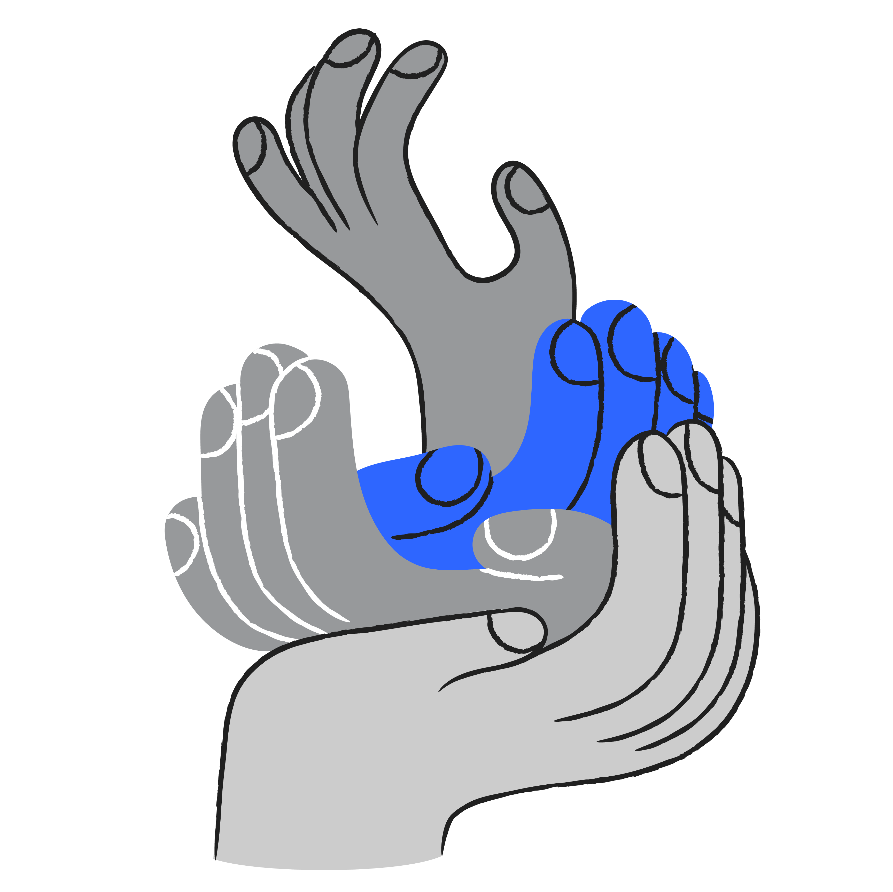
For more information, please contact
Firstname Lastname
  Title
  Professional Designations
  email@thrivent.com
Firstname Lastname
  Title
  Professional Designations
  email@thrivent.com
Certified Financial Planner Board of Standards, Inc. (CFP Board) owns the CFP® certification mark, the CERTIFIED FINANCIAL PLANNER™ certification mark, and the CFP® certification mark (with plaque design) logo in the United States, which it authorizes use of by individuals who successfully complete CFP Board’s initial and ongoing certification requirements.
Notes:
Add Contact Info

Slide 32
About Thrivent Charitable Impact & Investing
Thrivent Charitable Impact & Investing® brings hope to the world by empowering people to create the change that matters most to them. We open the joy of generosity to all by making it easy for anyone to give to the causes they cherish. We take a holistic, personalized approach to help our donors create strategic charitable plans, illuminating new paths to personalized impact through visionary models, tailored service and deep expertise. Ignited by our faith, we are passionate about creating positive impact and inspiring lasting change in our communities.

Slide 33
Thank you

