Slide 1

Qualified charitable distributions (QCDs)
3483550.5

Slide 2
Disclosure/Disclaimer
Thrivent Charitable Impact & Investing® is a public charity that serves individuals, organizations and the community through charitable planning, donor-advised funds and endowments. Thrivent Charitable Impact & Investing works collaboratively with Thrivent and its financial advisors. It is a separate legal entity from Thrivent, the marketing name for Thrivent Financial for Lutherans.
Insurance products, securities and investment advisory services are provided by appropriately appointed and licensed financial advisors and professionals. Only individuals who are financial advisors are credentialed to provide investment advisory services. Visit Thrivent.com or FINRA’s Broker Check for more information about Thrivent’s financial advisors.
Donors must itemize deductions to receive a charitable income tax deduction. Charitable giving can result in tax, legal and financial consequences. Thrivent, its financial professionals, and Thrivent Charitable Impact & Investing ®, do not provide legal, accounting, or tax advice. Consult your attorney or tax professional.
To ensure compliance with IRS requirements, be aware that any U.S. federal tax advice that may be contained in this presentation is not intended to be used, and cannot be used, for the purpose of (i) avoiding penalties under the Internal Revenue Code or (ii) promoting, marketing and recommending another party to any transaction or matter addressed herein.
Thrivent financial advisors and professionals have general knowledge of the Social Security tenets. For complete details on your situation, contact the Social Security Administration.
Thrivent and its financial advisors and professionals do not provide legal, accounting or tax advice. Consult your attorney or tax professional.
The donor’s experience may not be the same as other donors and does not indicate future performance or success.

Slide 3
Agenda
01
What is a qualified charitable distribution (QCD)?
02
Potential tax advantages of QCDs
03
How to make gifts of QCDs
Notes:
One strategic way to give now is through a Qualified Charitable Distribution, or what’s sometimes called the IRA charitable roll over. Today, we’ll learn more about this giving strategy, its potential tax benefits, and how you can integrate it into your charitable plan.

Slide 4

What is a Qualified Charitable Distribution (QCD)

Slide 5

What is a QCD?
Use a Qualified Charitable Distribution (QCD) to make a minimum distribution from your IRA.
Distribution goes directly to charity
Give up to $108,000 per/year, indexed to inflation going forward
SECURE 2.0 allows for one-time election to gift $54,000, in 2025, indexed to inflation going forward, to Gift Annuity or Charitable Remainder Trust
May avoid taxes on IRA distributions
Notes:
Those who are 70½ or older and those that are required to take minimum distributions from their IRA accounts can use a qualified charitable distribution to help meet this requirement.
For donors who’ve reached the age where they’re required to take minimum distributions from their IRA accounts, a qualified charitable distribution is a way to help meet that requirement, possibly avoid creating extra taxable income, and make a gift to charity.
For those 70½ and older, you can make a distribution from your IRA directly to charity.
You may avoid recognizing income from the distribution (for potential tax purposes); however, the QCD does count toward your required minimum distribution for the year.
You may give any amount, up to $108,000, annually, indexed to inflation going forward.
Note: The SECURE Act in 2019 changed required minimum distribution age to 72. (and SECURE 2.0 increases it incrementally to 73 then 75). However, it did not change the ability to do QCDs at age 70½.
SECURE 2.0 passed in December of 2022 expanded the definition of Qualified Charitable Distribution to include life income gifts. This “one-time election” must be used in a single year and is capped at $54,000, in 2025, indexed to inflation going forward. We'll talk more about this opportunity later.

Slide 6
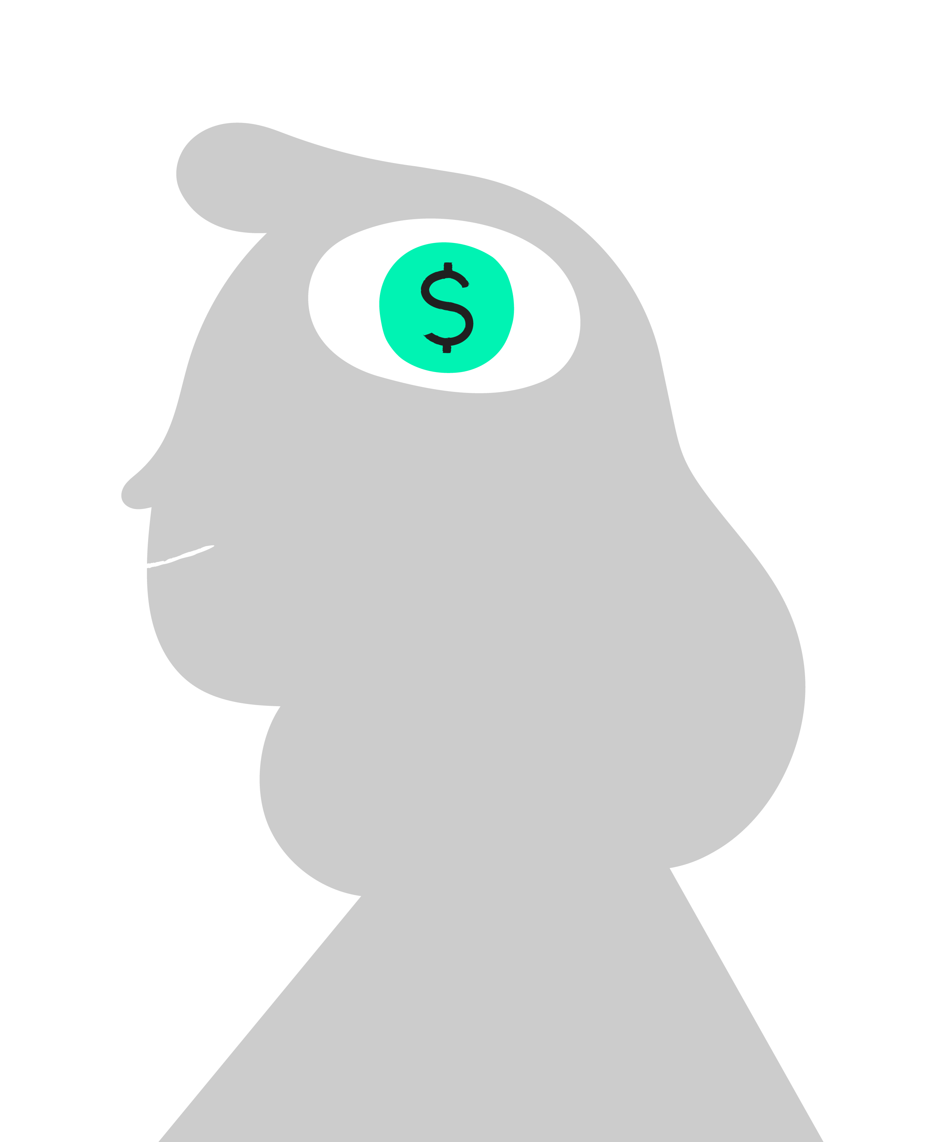
Potential Tax Advantages of QCDs

Slide 7
Potential tax advantages of QCDs
Benefit
Benefit
Benefit
The amount directed to Thrivent Charitable is not included in your adjusted gross income (AGI).
Lowers AGI which could reduce
Medicare premiums
Self-employment taxers
Social Security taxes
No income tax due from you on the IRA distributions
Notes:
Giving these assets to charity versus taking required minimum distributions (RMDs) into income may enable some donors to avoid certain disadvantages that can come with a higher adjusted gross income, such as higher Medicare premiums, self-employment or Social Security taxes, etc.
Unlike other charitable gifts, QCDs are not subject to percentage limitations on charitable deductions, making this an ideal strategy for donors who have maxed out charitable deductions or do not itemize deductions.

Slide 8

How to Make a Gift of QCDs

Slide 9
How and where to use QCDs
Give directly to charity or open a fund with possible benefits
Fund types
Benefits
Organizational endowment funds
Non-advised funds
Collaborative funds
Possible growth through sound stewardship
Easy ongoing support to multiple charities
Still goes directly to charity of your choosing
Notes:
QCDs may be given directly to the donor’s charity or charities each year; however, it may be more efficient to support favorite charities through a charitable fund at Thrivent Charitable. Through this charitable fund, you can provide ongoing support to one or more charities over time, and your gifts are invested to provide long-term support to charities through careful investment stewardship.
While the IRS does not allow qualified charitable distributions to benefit donor-advised funds, there are other options available through Thrivent Charitable. QCD gifts can provide charitable support in these ways:
Organizational endowment funds at Thrivent Charitable.
One of Thrivent Charitable’s collaborative funds.
A non-advised designated charitable fund.
We’ll discuss a couple of giving options for non-advised funds in the following slides.

Slide 10



Qualified charitable distributions (QCDs)
Give up to $108,000 annually (in 2025, indexed for inflation)
Distributions from the IRA or charitable fund go directly to the charity of your choosing
Give QCDs to establish a charitable fund
Donor’s QCD counts toward required minimum distributions
Donor
Non-Advised Charitable Fund
Charitable Support
May avoid taxes on IRA distributions
Lower AGI = Potentially multiple benefits
The donor’s experience may not be the same as other donors and does not indicate future performance or success.
Notes:
For donors who’ve reached the age where they’re required to take minimum distributions from their IRA accounts, a Qualified Charitable Distribution, is a way to help meet that requirement, avoid creating extra taxable income, and make a gift to charity.
For those 70-1/2 and older, you can make a distribution from your IRA directly to charity
You may avoid recognizing income from the distribution (for tax purposes); however,
The QCD does count toward your required minimum distribution for the year
You may give any amount, up to $108K annually (in 2025, indexed for inflation)
TAX ADVANTAGES OF GIVING QUALIFIED CHARITABLE DISTRIBUTIONS
Giving these assets to Thrivent Charitable, versus taking required minimum distributions (RMDs) into income, may enable you to avoid certain disadvantages that can come with a higher AGI, such as higher Medicare premiums, self-employment or Social Security taxes, etc.
There is no income tax due from you on the IRA distributions to Thrivent Charitable.
DONOR EXAMPLE
A woman in her mid-70’s who was very involved at her church always dreamed about being able to tithe and wanted to provide on-going to the congregation, even after she passed, but she wasn’t’ sure if she could afford to do so. She did have an IRA set aside, and didn’t need the income for living expenses, but was required to take minimum distributions each year, which would put her into a higher tax-bracket, affecting how her other income was taxed. Her financial professional suggested she might avoid having to recognize that IRA income each year, and meet her charitable goals by creating a fund at Thrivent Charitable. She created a charitable fund (non-advised) and made a QCD of $100,000 each year for two years to the fund – in essence rolling over her un-needed IRA to the fund. The fund now makes annual grant distributions to her church (so she doesn’t have to tithe from her remaining income), and those grants will continue every year continue for the donor’s lifetime and long after she’s gone.

Slide 11

Life insurance
Give life insurance, naming Thrivent
Charitable Impact & Investing® as owner and beneficiary
Grants from non-advised fund support selected charities
Donors
Charitable Fund
Charitable Support
Life Insurance
Annual QCDs are used to make premium payments on the life insurance contract
The donor’s experience may not be the same as other donors and does not indicate future performance or success.
Notes:
QCDs may also be used to make a significant charitable gift upon death by making a gift of life insurance. Each year, you make a QCD to us to cover premium payments for a life insurance contract that names Thrivent Charitable Impact & Investing as owner and beneficiary. Proceeds from this life insurance contract are directed to your charitable fund to provide ongoing support to one or more of your favorite charities after you’re gone.
DONOR EXAMPLE
A man in his mid-70s wanted to support favorite charities upon death and take advantage of the QCD opportunity. He was concerned required minimum distributions from his IRA would increase his adjusted gross income and affect Medicare premiums and Social Security taxes. He worked with our gift planners to create his charitable fund (non-advised) with a gift of an existing life insurance contract he no longer needed. He made Thrivent Charitable Impact & Investing the owner and beneficiary of the contract and makes QCD gifts annually to Thrivent to cover premium payments. Upon his death, proceeds from this life insurance contract will be directed to his charitable fund, which will make annual grant distributions to his named charities for 10 years and then close.

Slide 12
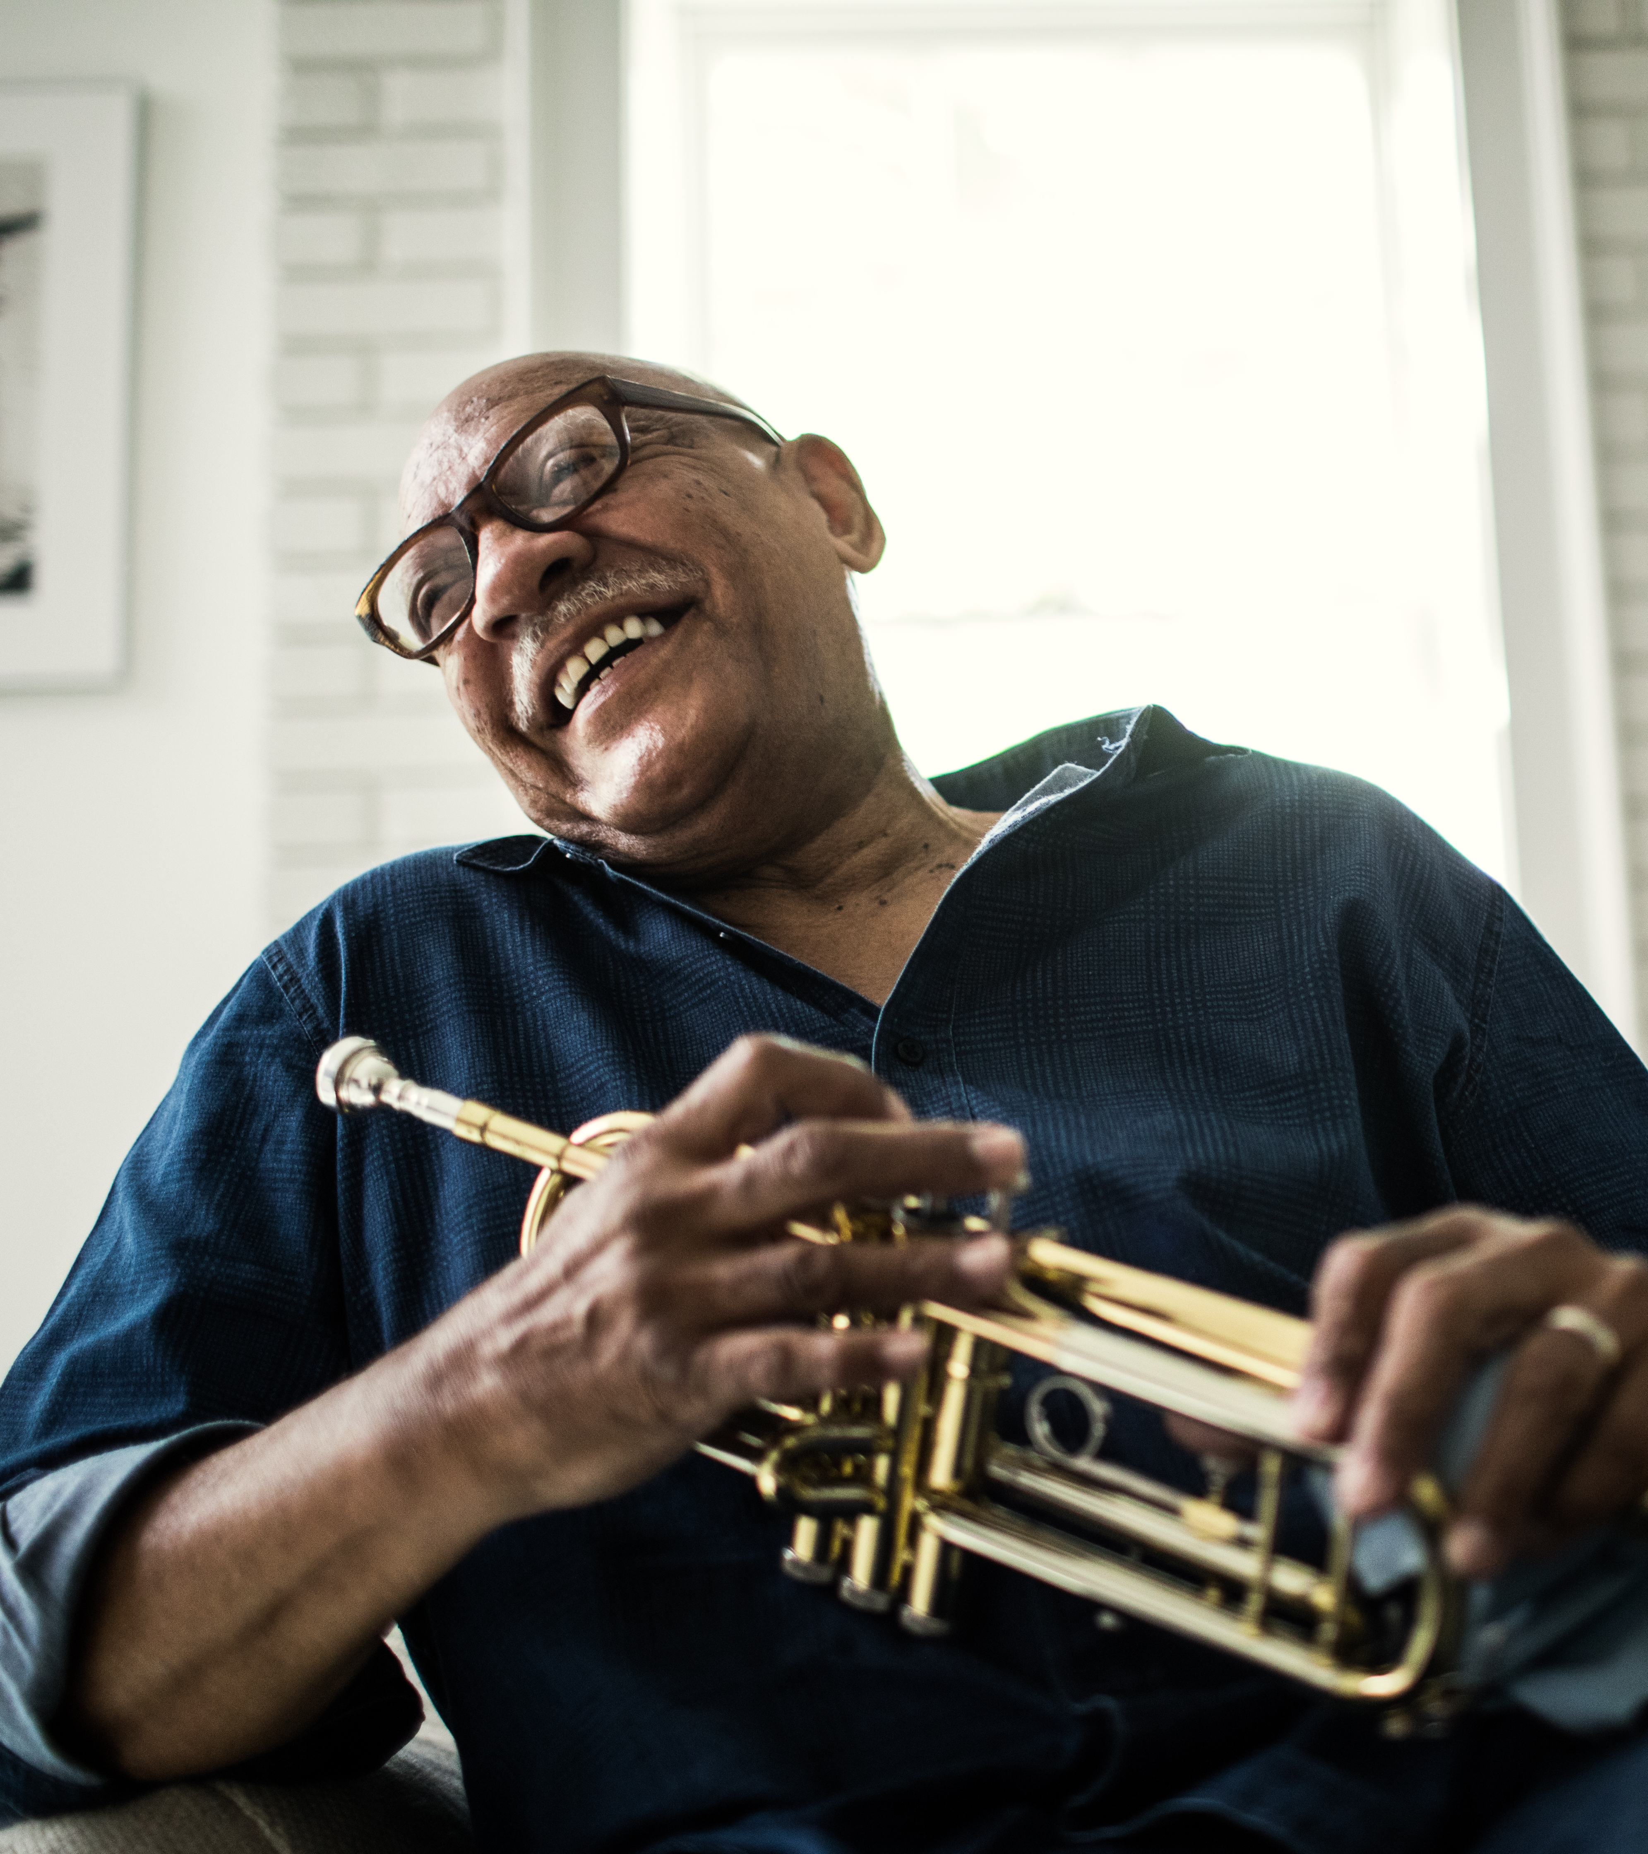
QCDs to Life Income Gifts: A $54K One-Time Election
Potential to spread out taxable income over lifetime payments, $54K in 2025, indexed for inflation
Clients who are 70½ and older, want lifetime income, and wish to make a gift to charity
Take lump sum income taxable in one year and turns it into a stream of income taxable over lifetime (single or joint)
A Charitable Gift Annuity (CGA) turns variable income from the IRA into fixed income
May be combined with outright $54K (in 2025, indexed for inflation) QCD for larger charitable impact
Notes:
For clients aged 70-1/2 or older who would like the option of taking a distribution from their IRA, and spreading the taxable income out over their lifetime, rather than recognizing it in a lump sum all in one year – the SECURE 2.0’s expansion of the definition of Qualified Charitable Distributions (in IRC Sec. 408(d)(8)) to include life income gifts may be a good opportunity.
Some things to consider:
This “one-time election” must be used in a single year
If the donor doesn’t use the full $54K, the unused portion doesn’t carry forward
$54K is for 2025, indexed for inflation
Must be immediate income (no deferred gift annuities)
income cannot be assignable (including to charity)
Limited to one $54,000 (in 2025 indexed for inflation) Qualified Distribution to a gift annuity or charitable remainder trust per lifetime.
Can be multiple contracts but must be in 1 calendar year.
Thrivent Charitable gift annuity minimum is $10K gift to open / charitable remainder annuity trust Minimum $50K gift to open / charitable remainder unitrust minimum $100K gift to open
Spouses could each gift $54K from separate IRAs to create one CRUT
Income beneficiaries of the gift annuity or charitable remainder trust are limited to the donor and/or their spouse.
All distributions from the gift annuity or charitable remainder trust will be taxed as ordinary income.
Payments from the gift annuity or charitable remainder trust must begin within 1 year. (no deferred income)
The gift annuity or charitable remainder trust cannot accept gifts of other types of assets.
Payment must be at least 5%.

Slide 13
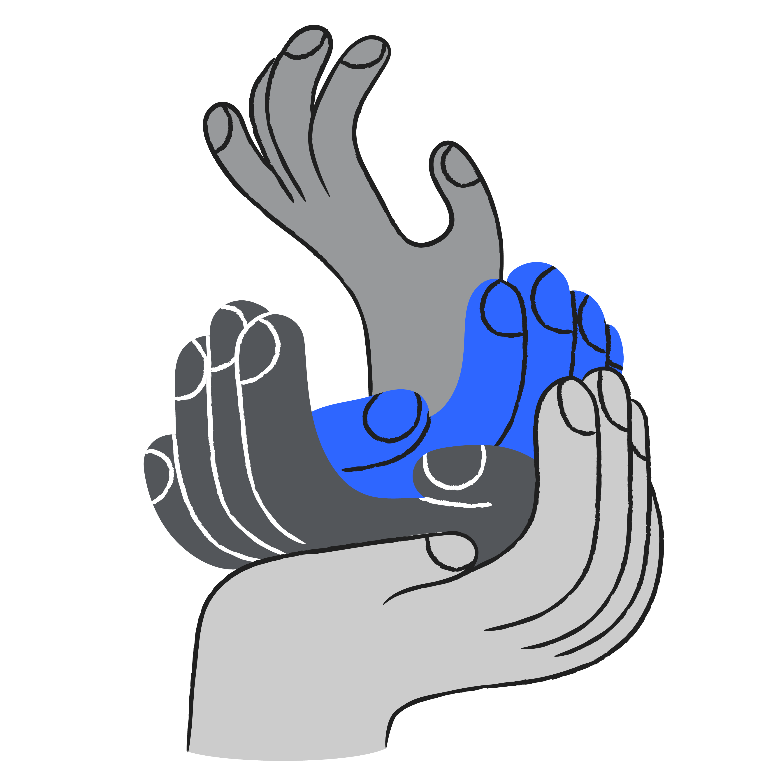
For more information, please contact
Firstname Lastname
Title Professional Designations email@thrivent.com
Firstname Lastname
Title Professional Designations email@thrivent.com
Notes:
Add contact information

Slide 14
Thank you

Slide 15
About Thrivent Charitable Impact & Investing
Thrivent Charitable Impact & Investing® brings hope to the world by empowering people to create the change that matters most to them. We open the joy of generosity to all by making it easy for anyone to give to the causes they cherish. We take a holistic, personalized approach to help our donors create strategic charitable plans, illuminating new paths to personalized impact through visionary models, tailored service and deep expertise. Ignited by our faith, we are passionate about creating positive impact and inspiring lasting change in our communities.

