Slide 1

Tax reform & charitable giving
3483335.4

Slide 2
Disclosure/Disclaimer
Thrivent Charitable Impact & Investing® is a public charity that serves individuals, organizations and the community through charitable planning, donor-advised funds and endowments. Thrivent Charitable Impact & Investing works collaboratively with Thrivent and its financial advisors. It is a separate legal entity from Thrivent, the marketing name for Thrivent Financial for Lutherans.
Insurance products, securities and investment advisory services are provided by appropriately appointed and licensed financial advisors and professionals. Only individuals who are financial advisors are credentialed to provide investment advisory services. Visit Thrivent.com or FINRA’s Broker Check for more information about Thrivent’s financial advisors.
Donors must itemize deductions to receive a charitable income tax deduction. Charitable giving can result in tax, legal and financial consequences. Thrivent, its financial professionals, and Thrivent Charitable Impact & Investing®, do not provide legal, accounting, or tax advice. Consult your attorney or tax professional.
To ensure compliance with IRS requirements, be aware that any U.S. federal tax advice that may be contained in this presentation is not intended to be used, and cannot be used, for the purpose of (i) avoiding penalties under the Internal Revenue Code or (ii) promoting, marketing and recommending another party to any transaction or matter addressed herein.
Donor’s experience may not be the same as other donors and does not indicate future performance or success.
Thrivent and its financial advisors and professionals do not provide legal, accounting or tax advice. Consult your attorney or tax professional.

Slide 3
Agenda
01
Tax & Jobs Act of 2017, SECURE Act of 2019 & Secure Act 2.0
02
Why people give
03
Emerging opportunities for giving
Notes:
Today we want to cover how these Acts of legislation may impact charitable giving to help you make informed decisions in your generosity and financial planning.

Slide 4

Tax & Jobs Act of 2017, SECURE Act of 2019 & Secure Act 2.0

Slide 5




Tax & Jobs Act of 2017
Standard deductions increased
Annual cash gift deduction limit increased
Tax Code Changes
Reduction of individual tax rates
Elimination of certain deductions
Notes:
First, let’s look at some of the changes in the tax code. With the changes, we’ve seen an elimination of some deductions, such as personal exemption, and caps on state and local taxes.
Standard deduction increased
The standard deduction in 2024 is $14,600 for singles and $29,200 for married filing jointly. For head of households, the standard deduction will be $21,900.
Annual cash gift deduction limit increased
The limit increased from 50% to 60% of adjusted gross income (AGI).
Reduction of individual tax rates
Highest rates were reduced to 37% (previously 39.6%).
Elimination of certain deductions
Certain deductions were eliminated, including personal exemption, home equity loan interest and caps on state and local taxes.

Slide 6
Benefits that remain after the 2017 Tax Reform
Charitable income tax deductions remain in place
Qualified Charitable Distributions (QCDs) are still available at age 70½
Annual Gross Income (AGI) limit increased
No changes for donor-advised funds, charitable gift annuities, charitable remainder trusts and other tax-qualified deferred gifts.
Notes:
Charitable income tax deductions remain in place
The charitable deduction came through the tax reform process relatively unchanged and was even enhanced for some making larger gifts.
QCDs are still available at age 70½
Those who are 70½ and older can make a gift of a qualified charitable distribution (QCD) from their IRA directly to charity, without having to recognize the income
Annual Gross Income (AGI) limit increased
The AGI limit increased from 50% to 60% of AGI.
No changes for donor-advised funds, charitable gift annuities, charitable remainder trusts and other tax-qualified deferred gifts.

Slide 7


Sunset of The Tax Cuts and Jobs Act (TCJA) at end of 2025
For individual taxpayers, the top individual, estate and trust income tax bracket goes back up to 39.6% from the current rate of 37%.
The Tax Cuts and Jobs Act (TCJA)
Reversal of changes to itemized deductions for individuals
The estate and gift exemption will revert to pre-TCJA levels
Annual deduction limit for charitable gifts of cash to public charities will sunset back to 50% of adjusted gross income
Notes:
The TCJA enacted certain provisions that had expiration dates, meaning they would expire or “sunset” at the end of 2025 unless extended by new legislation.
For individual taxpayers, the top individual, estate and trust income tax bracket goes back up to 39.6% from the current rate of 37%.
Reversal of changes to itemized deductions for individuals, such as those for medical expenses, charitable deductions, child tax credit, and others, and standard deduction will be returned to previous levels.
The estate and gift exemption will revert to pre-TCJA levels, effectively reduced by half, and expected to be in the ballpark of $6.5 million per individual or $13 million for a married couple.
Annual deduction limit for charitable gifts of cash to public charities will sunset back to 50% of AGI (from 60%)
Working together with your financial adviser, your attorney and your tax adviser to put a financial plan in place understanding both the tax provisions today and in potentially 2026 will help you prepare for whatever eventuality comes to fruition.

Slide 8
SECURE Act of 2019
“Stretch” IRAs no longer available for many non-spouse beneficiaries
Required Minimum Distribution (RMD) age increased from 70½ to 72
No age limit on IRA contributions
Notes:
The “Setting Every Community Up for Retirement Enhancement” Act (the SECURE Act) was signed into law in December 2019; provisions went into effect on January 1, 2020.
“Stretch” IRA no longer available for many non-spouse beneficiaries:
Previously, an IRA beneficiary could stretch RMDs over her life expectancy (assets in IRA continued to grow tax-free).
Same stretch rules applied to other defined contribution plans, such as 401(k)s, 403(b)s.
Non-spouse beneficiary more than 10 years younger than deceased owner must empty IRA within 10 years.
No RMDs during the 10 years.
Exceptions to 10-year rule (in addition to spouses and beneficiaries less than 10 years younger).
Minors (until they reach majority)
Disabled
Chronically ill
Age for RMDs increased from 70½ to 72:
Applies to owners who turn 70½ in 2020 or later (born on or after July 1, 1949).
Old rules apply to owners who turned 70½ before 2020: They would have an RMD in 2020 even if not yet 72 (exception for 2020 in CARES Act due to pandemic) and no RMDs in 2020 for anyone.
No age limit on IRA contribution:
Previously, IRA owner could contribute to IRA only until age 70½.
Now, working IRA owner can contribute to IRA so long as he/she is working.
May or may not choose to deduct contributions from taxable income.
If worker chooses to deduct post-70½ contributions:
Amount of subsequent QCD excludable from income is reduced by this amount.
Rest is reported as income and deductible.

Slide 9
SECURE Act 2.0 of 2022
Required Beginning Date (RBD) age to 75 in an incremental phase-in approach over the next 10 years.
  QCDs indexed for Inflation Annually
Lifetime Income Gifts now Eligible to be Funded by QCD – Limited to $50K once per lifetime.(indexed for inflation annually)
Notes:
The SECURE Act 2.0 became law on December 29, 2022. The new law includes provisions affecting retirement savings plans, which are intended to build on the 2019 SECURE Act, and are intended to make it more attractive for employers to offer retirement plans and improve outcomes for employees
Secure Act 2.0 increase the Required Beginning Date (RBD) age to 75 in an incremental phase-in approach over the next 10 years.
In the case of an individual who attains age 72 after December 31, 2022, and age 73 before January 2, 2033, the age for starting RMD is age 73.
In the case of an individual who attains age 74 after December 31, 2032, the applicable age is 75
Maximum Qualified Charitable Distributions (QCDs) Indexed to Inflation Annually
Since 2015 IRA owners could transfer up to $100,000 annually to charity without recognizing income, in the form of a qualified charitable distribution (QCD). Under SECURE 2.0, this amount gets indexed for inflation in $1,000 increments, allowing taxpayers to make larger tax-free gifts over time. The amount in 2024 is $105,000.
Lifetime Income Gifts now Eligible to be Funded by QCD – Limited to $50K once per lifetime
The SECURE Act 2.0 made one significant change to the Qualified Charitable Distribution rules. A QCD can now be used to fund a Charitable Gift Annuity (GA) or Charitable Remainder Trust (CRT). There is some fine print that you must know:
Limited to one $50,000 Qualified Distribution to a GA or CRT per lifetime.
This limit is indexed for inflation annually, and in 2024 it is $53,000.
Must be 70-1/2 or older
Can be multiple contracts, but must be in 1 calendar year. (i.e. Could do 5 $10K gift annuities to multiple charities, as long as in same year.)
Income beneficiaries of the GA or CRT are limited to the donor and/or their spouse.
All distributions from the GA or CRT will be taxed as ordinary income.
Payments from the GA or CRT must begin within 1 year. (no deferred income)
The GA or CRT cannot accept gifts of other types of assets.
Could add other QCDs to CRUT, (i.e. wife gifts $50K then husband adds his from own IRA later, if meet minimum requirement at charity)
Payment must be at least 5%.
This is legal requirement with CRTs, but not so with Gift Annuities. With gift annuities the American Council for Gift Annuities Recommended rates for a single 70-1/2-year-old would meet this requirement, but if joint payout and spouses have significant age difference, could cause issue. (i.e. ACGA recommended rate for 73 and 63 = 4.9%. Thrivent Charitable’s state registrations limits us to using ACGA recommended rates.)
In most cases, CRTs have larger minimums as they’re more complicated to set up and administer, so likely mostly talking about gift annuities.
At Thrivent Charitable our minimum for CRUTs is $100K, so if husband and wife each made gift of $50K from their separate IRAs, could do CRUT.

Slide 10

Why people give
Notes:
How will these changes affect people’s giving? To discover the answer, let’s discuss the most common reasons why people give.

Slide 11




Why do people give?*
Help others
Out of gratitude
In response to life’s blessings
Positive impact in people’s lives
* Source: 2023 Thrivent Charitable Donor Satisfaction Survey
Notes:
Our research shows us the motivation for why people give isn’t as much about potential financial benefits as it is about helping others and giving out of gratitude.

Slide 12

Emerging opportunities for giving
Notes:
While we know donors aren’t strictly motivated by potential tax benefits, there are still some strategies that can help make giving more affordable.

Slide 13

Bundling charitable gifts
$
Give multiple years’ worth in one year
$
$
Bundling Charitable Gifts
Benefits
Reach threshold required for itemization
$
$
Distribute to charities of choice over multiple years while taking the higher standardized deduction
$
$
Notes:
While we know donors aren’t strictly motivated by potential tax benefits, there are still some strategies that can help make giving more affordable. Following recent tax reform, two giving solutions that have grown in popularity given higher thresholds for itemized deductions: qualified charitable distributions and “bundling” charitable gifts.
Bundling: Bundling, or bunching charitable gifts into one tax year, is a strategy that might make sense for some. By making use of a donor-advised fund, supporters can give multiple years’ worth of gifts in one year to get above the standard deduction amount. They would itemize that year and may take the charitable deduction for the larger gift and distribute support from the donor-advised fund to the church or other charities over the next two to three years, while taking the higher standard deduction.
Donors can give cash or give long-term appreciated assets and may avoid capital gains, one of many giving benefits that remain in place under the new tax law. Long-term appreciated assets also serve as an attractive option to pay life insurance premium payments for a contract that’s given to a charity.

Slide 14

Qualified charitable distributions (QCDs)
Distributions from the non-advised charitable fund go directly to the charity of your choosing
Donor’s QCD counts toward required minimum distributions
Non-Advised Charitable Fund
Charitable Support
Supporters
You may avoid the need to itemize to recognize tax savings
You may avoid taxes on your IRA distributions
Notes:
Note: QCDs CANNOT go into a donor-advised fund. They can go directly to charity, to an endowment fund at Thrivent Charitable or to a non-advised fund that the donor establishes with us (but can’t change going forward). QCDs may also be used to make premium payments on a life insurance contract that you gift to the endowment or non-advised fund, allowing you to make a much bigger gift upon death.

Slide 15
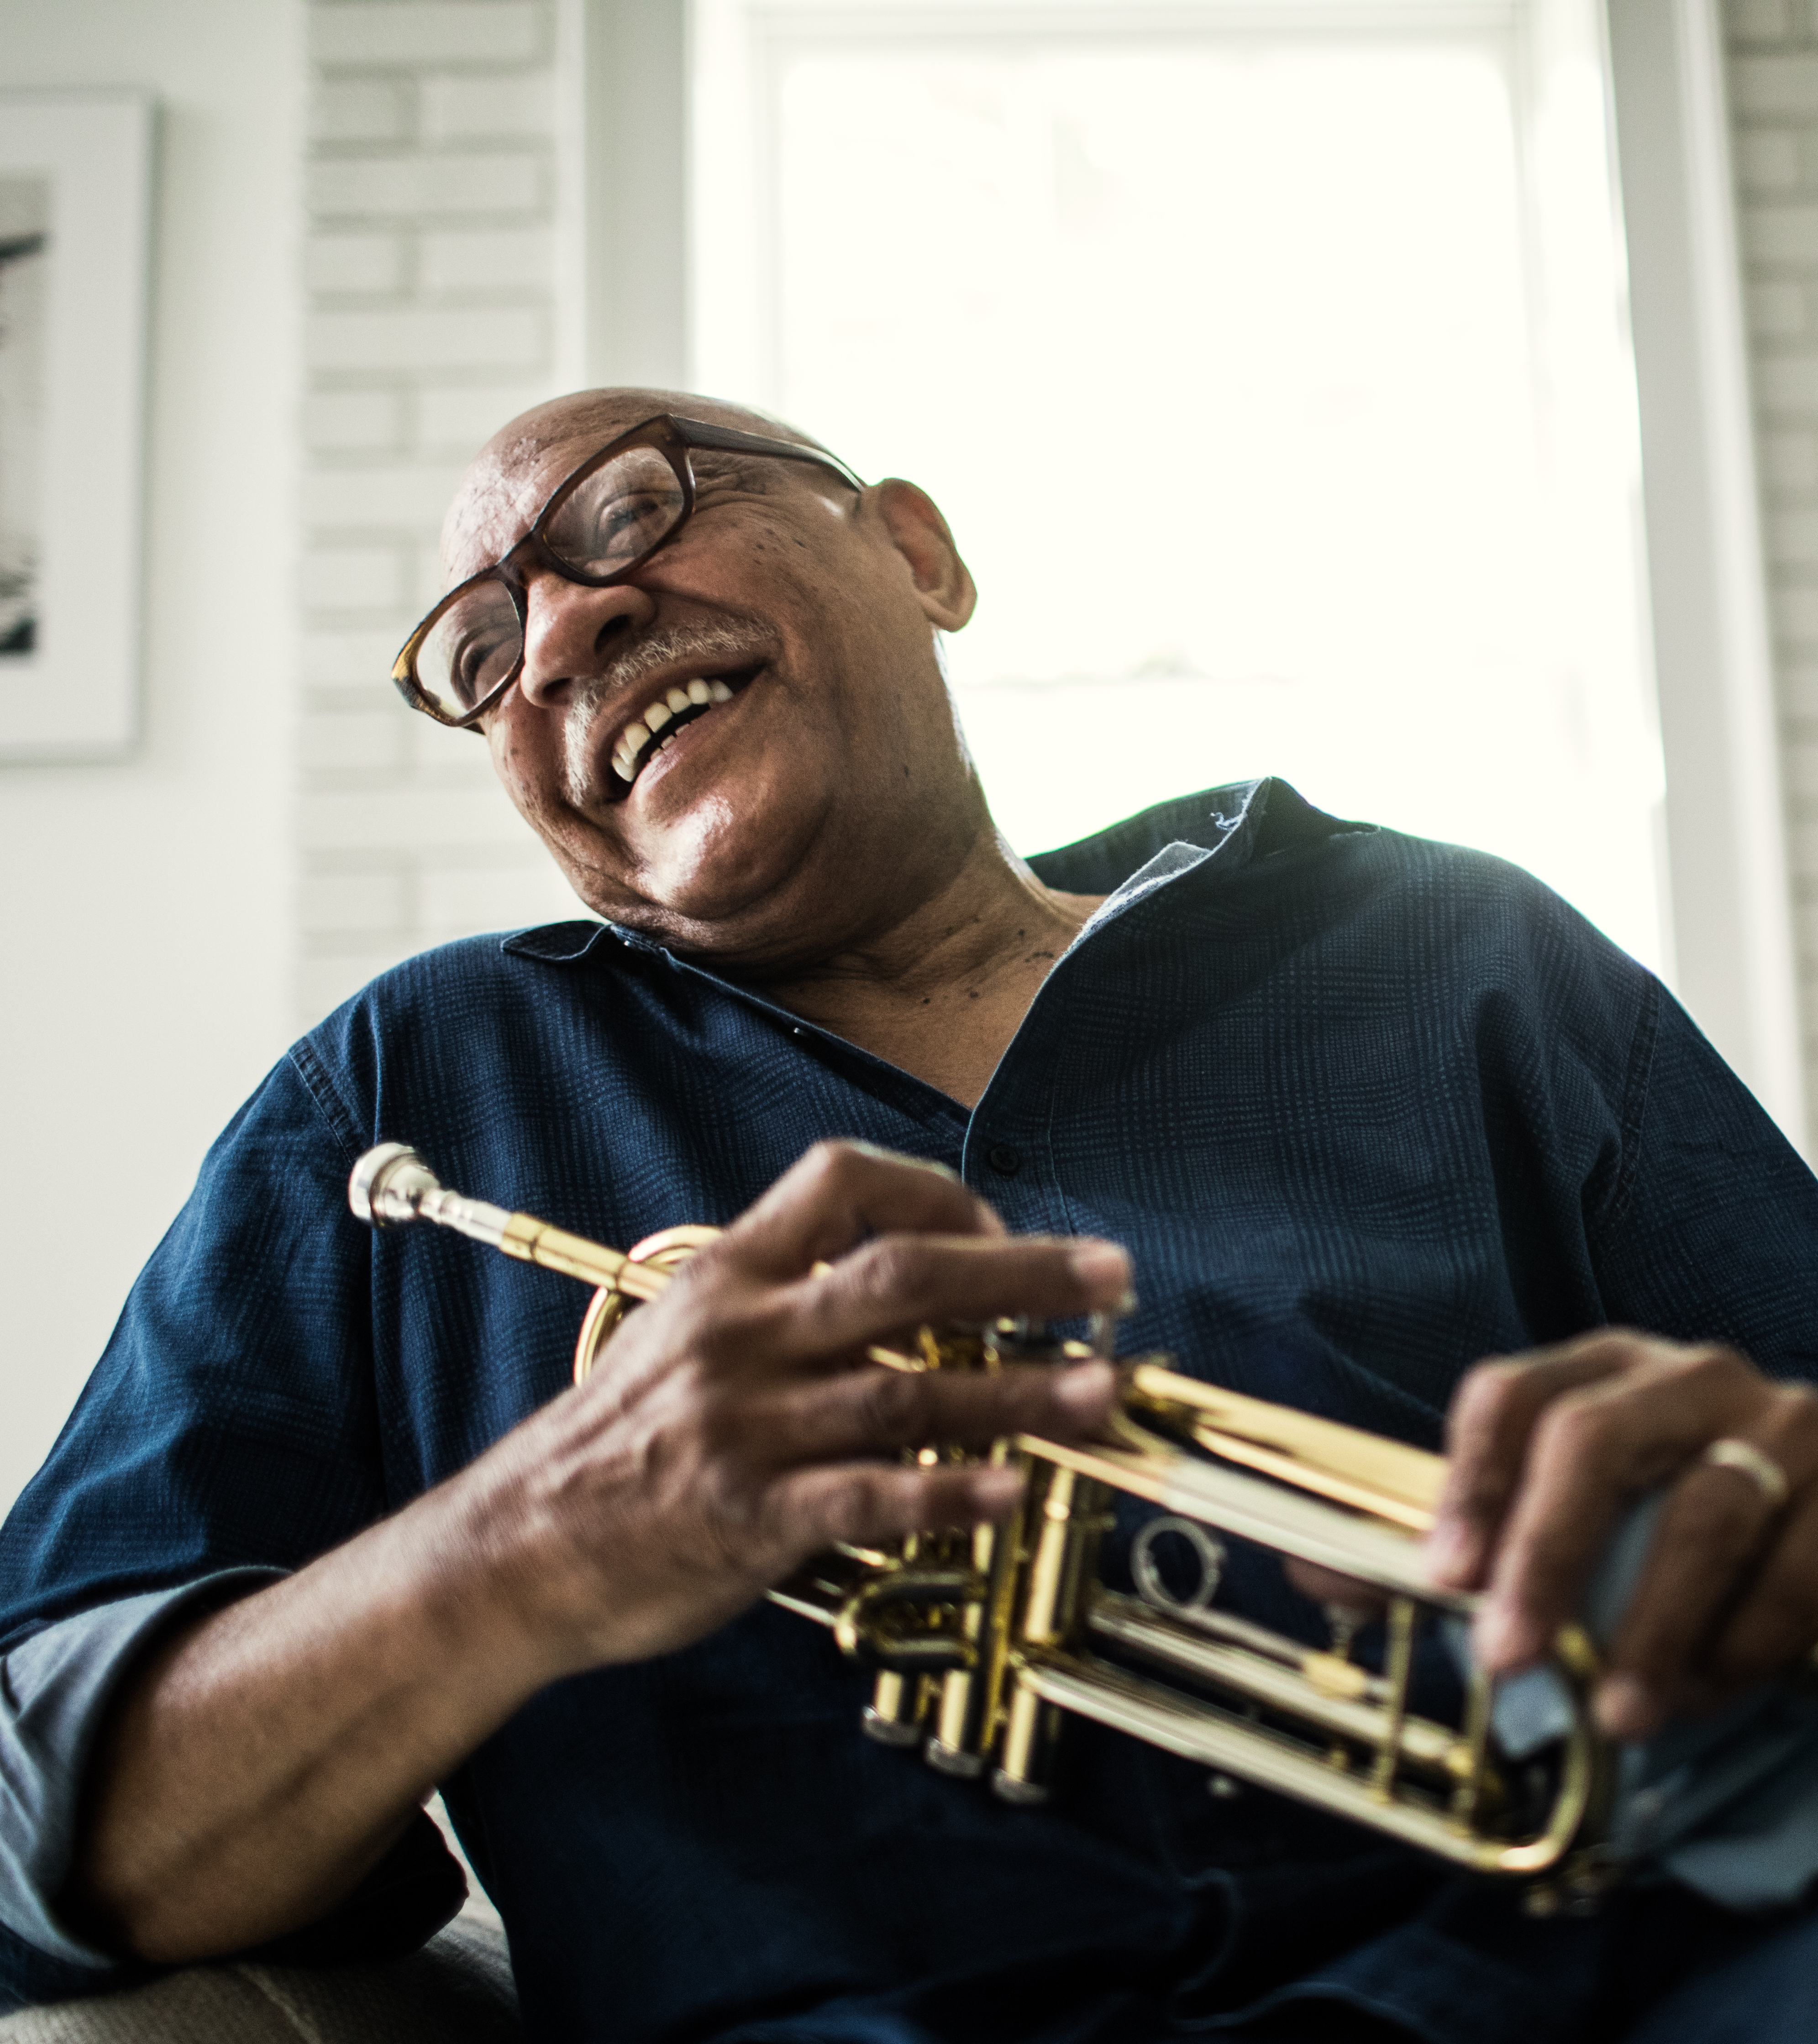
QCDs to Life Income Gifts:
$53K lifetime opportunity
Potential to spread out taxable income over lifetime payments, $53K in 2024, indexed for inflation
Clients who are 70½ and older, want lifetime income, and wish to make a gift to charity
Take lump sum income taxable in one year and turns it into a stream of income taxable over lifetime (single or joint)
A Charitable Gift Annuity (CGA) turns variable income from the IRA into fixed income
May be combined with outright $52K (in 2024, indexed for inflation) QCD for larger charitable impact
Notes:
For clients aged 70-1/2 or older who would like the option of taking a distribution from their IRA, and spreading the taxable income out over their lifetime, rather than recognizing it in a lump sum all in one year – the SECURE 2.0’s expansion of the definition of Qualified Charitable Distributions in IRC Sec. 408(d)(8) to include life income gifts may be a good opportunity.
This “one-time election” must be used in a single year
If the donor doesn’t use the full $53K, the unused portion doesn’t carry forward
$53K is for 2024, indexed for inflation
Must be immediate income (no deferred gift annuities)
income cannot be assignable (including to charity)
Limited to one $53,000 (in 2024 indexed for inflation) Qualified Distribution to a gift annuity or charitable remainder trust per lifetime.
Can be multiple contracts, but must be in 1 calendar year.
Thrivent Charitable gift annuity minimum is $10K / CRAT Minimum $50K / CRUT minimum $100K
Spouses could each gift $50K from separate IRAs to create one CRUT
Income beneficiaries of the GA or CRT are limited to the donor and/or their spouse.
All distributions from the GA or CRT will be taxed as ordinary income.
Payments from the GA or CRT must begin within 1 year. (no deferred income)
The GA or CRT cannot accept gifts of other types of assets.
Payment must be at least 5%.

Slide 16
Giving long-term appreciated assets
Donor gives long-term appreciated assets
Possibly resulting in an even larger gift than originally expected
You may receive tax savings by avoiding recognition of capital gain.
You may avoid the need to itemize to recognize tax savings
Donors
Donor-advised fund
Charitable Support
Notes:
With fewer people itemizing, many may be looking to give assets that provide a tax benefit, even without claiming an income tax deduction. When clients give long-term appreciated assets, such as stock, mutual funds or real estate, they may avoid recognition of the capital gain, which would otherwise be taxable.
If clients itemize, they may deduct the full fair market value of the gift; however, charitable income tax deductions for capital gain assets are capped at 30% of the donors AGI in the year of the gift, and any unused portion of the deduction exceeding this threshold may be carried forward for an additional five tax years. The result is often an even larger charitable gift than may have been expected if the client had sold the asset and gifted cash.

Slide 17
Testamentary charitable remainder trust
IRA legacy gift is converted to ongoing income payments to heirs
Payments are made to heirs for a lifetime or for a term of up to 20 years
At the end of the trust, the remainder benefits the charitable fund
Donors
Trust
Charitable Support
Possible tax-free growth within trust
Possibility of no income tax when CRT funded
Notes:
Through a testamentary charitable remainder unitrust, your legacy gift of your IRA is converted to ongoing income payments to heirs for a lifetime or a term of up to 20 years. At the end of the trust, the remainder benefits your charitable fund.
Testamentary CRT a potential alternative to “stretch” IRA:
Payments for lives of beneficiaries or term of up to 20 years.
Possibility of no income tax when CRT funded.
Possible tax-free growth within trust.
Income tax applied to beneficiary payments only.

Slide 18
Beneficiary proceeds & wealth replacement
Name Thrivent Charitable as beneficiary and retain control of assets while living
Designated charities receive automatic annual grants for a term of years or in perpetuity
Donors
Charitable Fund
Charitable Support
Heirs may avoid income taxes on assets given, taxable estate may be reduced
Receives beneficiary proceeds upon your death
Notes:
With the stretch IRA being eliminated, IRAs are even more attractive to gift at death. Many use life insurance as a wealth replacement tool, replacing an amount given to charity with a possible tax efficient death benefit for heirs.
Name Thrivent Charitable Impact & Investing as beneficiary and retain control of assets while living.
Designated charities receive automatic annual grants for term of years or in perpetuity.
Heirs may avoid income taxes on assets given, taxable estate is reduced.

Slide 19
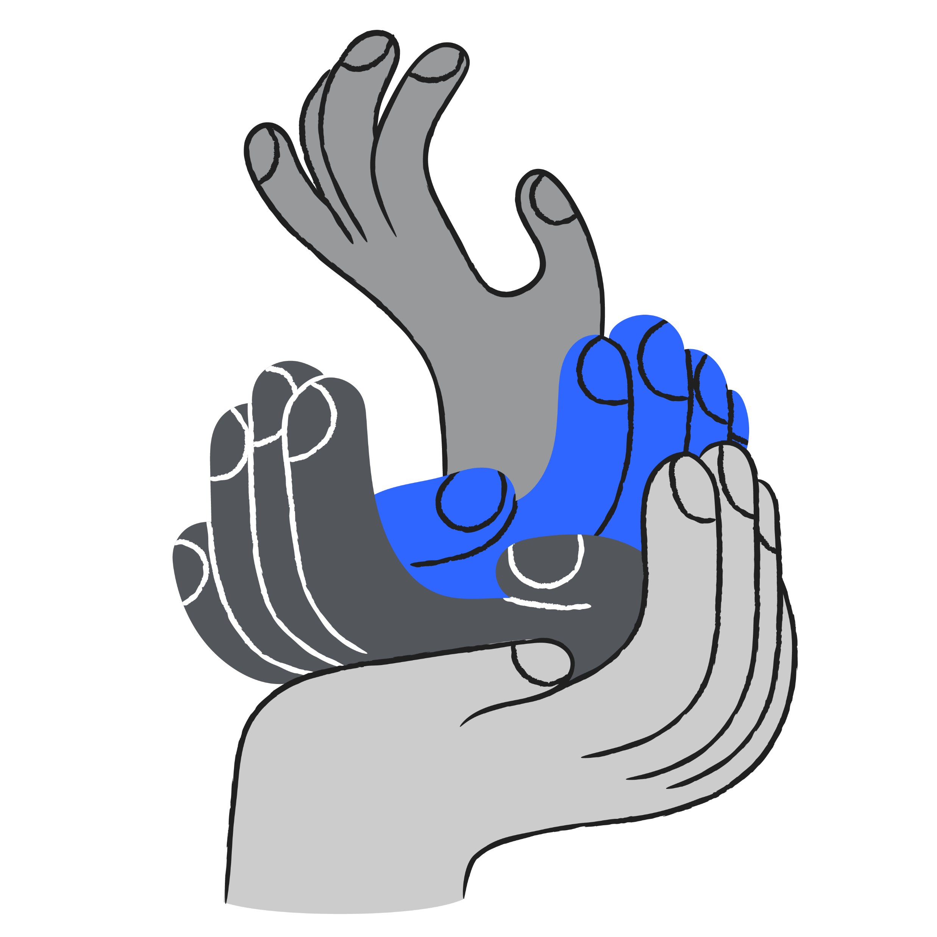
For more information, please contact
Firstname Lastname
  Title
  Professional designations
  email@thrivent.com
Firstname Lastname
  Title
  Professional designations
  email@thrivent.com
Certified Financial Planner Board of Standards, Inc. (CFP Board) owns the CFP® certification mark, the CERTIFIED FINANCIAL PLANNER™ certification mark, and the CFP® certification mark (with plaque design) logo in the United States, which it authorizes use of by individuals who successfully complete CFP Board’s initial and ongoing certification requirements.
Notes:
Add contact information

Slide 20
About Thrivent Charitable Impact & Investing
Thrivent Charitable Impact & Investing® brings hope to the world by empowering people to create the change that matters most to them. We open the joy of generosity to all by making it easy for anyone to give to the causes they cherish. We take a holistic, personalized approach to help our donors create strategic charitable plans, illuminating new paths to personalized impact through visionary models, tailored service and deep expertise. Ignited by our faith, we are passionate about creating positive impact and inspiring lasting change in our communities.

Slide 21
Thank you

