Slide 1

Charitable planning to maximize impact
3254348.5

Slide 2
Disclosure/Disclaimer
Thrivent Charitable Impact & Investing® is a public charity that serves individuals, organizations and the community through charitable planning, donor-advised funds and endowments. Thrivent Charitable Impact & Investing works collaboratively with Thrivent and its financial advisors. It is a separate legal entity from Thrivent, the marketing name for Thrivent Financial for Lutherans.
Insurance products, securities and investment advisory services are provided by appropriately appointed and licensed financial advisors and professionals. Only individuals who are financial advisors are credentialed to provide investment advisory services. Visit Thrivent.com or FINRA’s Broker Check for more information about Thrivent’s financial advisors.
The donor’s experience may not be the same as other donors and does not indicate future performance or success.
Donors must itemize deductions to receive a charitable income tax deduction. Charitable giving can result in tax, legal and financial consequences. Thrivent, its financial professionals, and Thrivent Charitable Impact & Investing®, do not provide legal, accounting, or tax advice. Consult your attorney or tax professional.
To ensure compliance with IRS requirements, be aware that any U.S. federal tax advice that may be contained in this presentation is not intended to be used, and cannot be used, for the purpose of (i) avoiding penalties under the Internal Revenue Code or (ii) promoting, marketing and recommending another party to any transaction or matter addressed herein.

Slide 3




Why do people give?*
Help others
Out of gratitude
In response to life’s blessings
Positive impact in people’s lives
* Source: 2023 Thrivent Charitable Donor Satisfaction Survey
Notes:
First, let’s discuss the most common reasons of why people give.
Based on survey responses from thousands who give through Thrivent Charitable, the top motivators for giving are:
To help others
To give out of gratitude or in response to life’s blessings
Brings them joy
Potential tax advantages

Slide 4



Expressing your generosity
Spontaneous giving
Intentional giving
Planned giving
Notes:
Each of us chooses to give in different ways and times.
Spontaneous giving is typically spur of the moment and donations are smaller. Examples include disaster relief efforts and neighbors in need.
Intentional giving includes donations made on a regular basis. Examples include giving to your church or other favorite charities.
Planned giving is part of an overall financial strategy. Did you know that almost everyone has the ability to make a planned gift? However, only around 37% of Americans know about their ability to give during their lifetime that supports after their death, which is a missed opportunity to support charities and causes that mean the most to you.*
This is where I can help you develop a giving plan designed to match your charitable interests and financial circumstances. This kind of generosity can be implemented while living or after death.
*http://www.thefundraisingauthority.com/planned-giving/20-facts-about-planned-giving/

Slide 5



How a Charitable Fund Works
Give
Give Now. Give Later. Give & Receive™.
Grow
Charitable fund
Grant
Distributions
Donor contributes assets to the charitable fund
Gifts are invested with sound stewardship and within your risk tolerance to potentially expand your charitable impact
Donor recommends grants to the charities and causes of their choice over time
Notes:
How does a Charitable Fund work?
The donor contributes to the fund, the assets are invested in the fund for potential growth, and the donor recommends grants to the charities and causes of their choice over time.
There are many ways to make gifts to establish the fund, you can Give Now, Give Later or Give and Receive.

Slide 6

Ways to give
Give Now. Give Later. Give & Receive.™
Notes:
First, we’ll discuss a few gifts that are in the category of “Give Now.”

Slide 7
Categories of Giving
There are three common ways to give charitably.
Each of these giving methods may benefit your charitable fund.
1
2
3
Give Now
Give Later
Give & Receive
Cash
Securities
Qualified charitable distributions (QCDs)
Real estate
Gift through will
Beneficiary designation
Life insurance
Life estate reserved
Lifetime income from charitable gift annuities or charitable remainder trusts
Notes:
To help you understand all the charitable giving opportunities, let’s break it down into three categories: Give Now, Give Later and Give & Receive – which may be an option for you depending on your personal situation and goals.

Slide 8
Give Now.
Give Later.
Give & Receive.™
Notes:
First, we’ll discuss a few gifts that are in the category of “Give Now.”

Slide 9
We’re all familiar with the concept of taking out our checkbook and donating in response to an appeal, but we can also be more strategic and give in bigger, wiser ways.
1
Give Now
For people who
Cash.
Publicly traded securities.
Real estate.
Closely held stock.
Qualified charitable distributions (QCDs) from IRA.
Crops/farm equipment.
Limited or general partnerships.
Limited liability company.
Want to provide charitable support now, while living.
Want to give long-term assets and avoid paying taxes on capital gains.
Wish to include family in giving decisions.
Seek a potential charitable deduction.
Notes:
We’re all familiar with the concept of taking out our checkbook and donating in response to an appeal which is great, but we can also be more strategic, and potentially give in bigger, wiser ways.
There are a few strategies that may assist you to “Give Now” such as Appreciated Assets (long-term assets), an IRA Charitable Rollover (what’s often called a Qualified Charitable Distribution) and/or cash from the proceeds of sale of real estate or a business.
Let’s hear a couple examples of Give Now.

Slide 10
Donor-advised funds
Give assets to Thrivent Charitable to establish fund
Grants from donor-advised fund support donors’ selected charities
Donors
Donor-Advised Fund
Charitable Support
Donors may receive income tax deduction
Notes:
EXAMPLE: SALE OF A BUSINESS
With a donor-advised fund, you can make the gift today and you may receive the tax deduction when you need it, and distribute support to charities later, either over time, or when the timing is right for you and your selected charities.
A great example this type of giving is a family from the Pacific Northwest. They had a family tradition; ever since the first grandchild turned 8-years-old and he got to go on a summer trip with grandma and grandpa, all by himself, without his parents along. Then as each successive grandchild reached the age of 8, they got to come along on the trip as well. Until what had started out as a few family members on trip somewhere by plane, turned into several cars full of 16 grandchildren and the grandparents caravanning across country, with the older kids helping to drive and look out for the younger ones.
When it came time for the grandparents to simplify in retirement, the woman decided to sell off the business she’d built up over the years. They knew they would need to do some planning around the sale and what to do with the proceeds. They also wanted to incorporate charitable giving but weren’t sure what the best way to do it was. They met with their financial advisor, who suggested they think about a donor-advised fund. He explained that by establishing a fund in the year of the sale, they could make a gift with some of the proceeds, thus off-setting some of the income with a potential tax deduction. However, they could take their time granting money from the fund to charities they cared about in retirement.
They loved the idea and thought it would be a great way to pass on their faith and philanthropic values to their grandchildren. So, they made a gift and established a charitable fund. Now every year when they’re on their annual trip with the grandkids, they talk about what charities they want to benefit from the fund and why, all the kids can bring forward ideas and share in the decision. Then, later when grandma and grandpa pass away, the grandkids will take over as advisors to the fund and continue the tradition.

Slide 11
Appreciated securities
Give assets to Thrivent Charitable to establish fund
Grants from donor-advised fund support donors’ selected charities
Supporters
Donor-Advised Fund
Charitable Support
Donors may receive income tax deduction
Notes:
Sometimes donors have very busy lives and have found it appealing to centralize their giving in one account so that they no longer need to track all their gifts and gift receipts. A fund can benefit any IRS qualified charity.
DONOR STORY
Let’s say a man in his late 40s wants to create a centralized giving account using appreciated stock. He works with Thrivent Charitable to establish a donor-advised fund with $25,000 in stock, potentially bypassing capital gain. He may also receive an immediate charitable tax deduction. Through his fund, he supports multiple local and national charities and chooses when, where and how much is distributed.

Slide 12
Qualified charitable distributions (QCDs)
Give QCDs to establish fund
Donor’s QCD counts toward required minimum distributions
Non-advised charitable fund
Grants from non-advised fund support selected charities
Charitable Support
Donor
Income tax may not be owed
*Thrivent financial advisors and professionals have general knowledge of the Social Security tenets. For complete details on your situation, contact the Social Security Administration.
Notes:
For donors who’ve reached the age where they’re required to take minimum distributions from their IRA accounts, a Qualified Charitable Distribution, is a way to help meet that requirement, avoid creating extra taxable income, and make a gift to charity.
For those 70-1/2 and older, you can make a distribution from your IRA directly to charity
You may avoid recognizing income from the distribution (for tax purposes); however,
The QCD does count toward your required minimum distribution for the year
TAX ADVANTAGES OF GIVING QUALIFIED CHARITABLE DISTRIBUTIONS
Giving these assets to Thrivent Charitable, versus taking required minimum distributions (RMDs) into income, may enable you to avoid certain disadvantages that can come with a higher AGI, such as higher Medicare premiums, self-employment or Social Security taxes, etc.
There may be no income tax due from you on the IRA distributions to Thrivent Charitable.
DONOR EXAMPLE
A woman in her mid-70’s who was very involved at her church always dreamed about being able to tithe and wanted to provide on-going to the congregation, even after she passed, but she wasn’t sure if she could afford to do so. She did have an IRA set aside, and didn’t need the income for living expenses. But was required to take minimum distributions each year, which would put her into a higher tax-bracket, affecting how her other income was taxed. Her financial advisor suggested she might avoid having to recognize that IRA income each year and meet her charitable goals by creating a fund at Thrivent Charitable. She created a non-advised charitable fund and made a QCD of $100,000 each year for two years to the fund – in essence rolling over her un-needed IRA to the fund. The fund now makes annual grant distributions to her church (so she doesn’t have to tithe from her remaining income), and those grants may continue every year continue for the donor’s lifetime and long after she’s gone.

Slide 13
Give Now.
Give Later.
Give & Receive.™
Notes:
Now we’ll discuss a few gifts that are in the category of “Give Later.”

Slide 14
Many people need or want the flexibility to use their assets while living but also want to continue to support the charities and causes that are important to them after their passing. “Give Later” options provide those opportunities.
Give Later
For people who
Life insurance
Beneficiary proceeds and bequests
Will or living trust
Life estate reserved
Want to create a legacy by making a significant gift upon death
Wish to retain control of assets while living
Want to help heirs avoid estate taxes on gifts of qualified retirement assets
Notes:
“Give Later” gifts are popular giving options because many people may need or want the flexibility to use their assets while living but also want to continue to support the charities and causes that are important to them after their passing.
Examples of “Give Later” gifts are: Gifts through will, Beneficiary Proceeds, and gifts of Life Insurance.
Here are examples of Give Later

Slide 15

Life insurance
Designated charities receive automatic annual grants for term of years or in perpetuity
Give life insurance, naming Thrivent
Charitable as owner and beneficiary
Supporters
Life Insurance
Charitable Fund
Charitable Support
Annual premium payments are charitable gifts that may provide an income tax deduction for the supporter
Notes:
EXAMPLE: LIFE INSURANCE
Many people are familiar with the idea of naming a charity as a beneficiary of a retirement account or life insurance contract, but did you know there is a way to use life insurance strategically to leverage smaller gifts during a lifetime into a much larger gift at death?
DONOR EXAMPLE
One of Thrivent Charitable’s very first donors used this technique. She was a music teacher and wanted to leave enough money to her local church school’s endowment fund to help support the music program, since she was concerned that it was always one of the first things to get cut when the budget was tight. However, she wasn’t wealthy and didn’t think she would have enough money to meet her goal. With the help of her financial advisor, she developed a strategy for her to take out a life insurance policy and donate it to her donor-advised fund. Once the policy is owned by Thrivent Charitable, the premium payments she makes each year may be tax deductible. She can leverage an affordable annual gift into a much larger death benefit that will support charities and causes that mean the most to her far into the future.

Slide 16
Beneficiary Proceeds & Bequests
Name Thrivent Charitable as beneficiary and retain control of assets while living
Designated charities receive automatic annual grants for term of years or in perpetuity
Donors
Donor-Advised Fund
Charitable Support
Heirs may avoid income taxes on assets given, taxable estate may be reduced
Receives beneficiary proceeds upon your death
Notes:
Giving through your will or living trust, or naming charity as a beneficiary on retirement or other accounts, is a simple, flexible way to act on your values and charitable interests.
Whether your assets are IRAs or other qualified retirement assets, life insurance, annuities, investments or real estate, they provide an opportunity to support charities and causes that mean the most to you. We’re here to help.
Sharing all or a portion of these assets, you benefit in these ways:
1. You make a significant gift, oftentimes larger than what you could have made while living;
2. You retain control of your assets while living and have the flexibility to make changes as needed; and
3. By giving through a donor-advised fund, your gift supports multiple charities through one simple designation.
DONOR EXAMPLE – Beneficiary Proceeds
A couple in their 70s wanted to control of their assets while living in case they needed them in retirement but were aware that IRAs inherited by family may be subject to income tax and possibly, estate tax. By naming Thrivent Charitable Impact & Investing as beneficiary of their IRAs, the donors retains access to these assets while living. Upon their deaths, remaining IRA assets are directed to their donor-advised fund to benefit their favorite charities.
The tax treatment of inherited assets can vary depending on the type of asset and the recipient. Thrivent Charitable, your financial advisor and you can team together to help identify which assets are may be best to leave to charity and which may be best to leave to loved ones.
DONOR EXAMPLE - Bequests
The Donors: A couple, 66 and 72, wanted to share what’s left of their assets (upon death) with their adult children, church and other favorite charities. They’re aware IRA assets inherited by family may be subject to income tax and possibly estate tax.
Their Gift: They named Thrivent Charitable Impact & Investing as beneficiary of their IRAs and established a donor-advised fund to support their church and two additional charities. Their adult children are named in their wills to receive the remaining assets from the estate.

Slide 17
Give Now.
Give Later.
Give & Receive.™
Notes:
Now we’ll discuss a few gifts that are in the category of “Give & Receive.”

Slide 18
You can also make a charitable gift and receive ongoing income payments for life or a term of years. The remainder provides charitable support.
3
Give & Receive
For people who
Charitable gift annuity
  Immediate
  Deferred
  Flexible deferred
Charitable remainder trust
  CRAT
  CRUT
  Flip-CRUT
Own assets you want converted to income payments.
Own long-term appreciated securities.
May seek to avoid market volatility.
Seek a potential charitable deduction for portion of gift assets.
For people who
Notes:
There are two options for “Give & Receive” gifts: a Charitable Gift Annuity and a Charitable Remainder Trust.
Thrivent Charitable offers both, depending on the type of income you want and what assets you may have to give.
Let’s look at some examples of Give and Receive.

Slide 19

Charitable Gift Annuity
Designated charities receive automatic annual grants for term of years or in perpetuity
Gift of cash or appreciated securities
Charitable Gift Annuity
Charitable Fund
Charitable Support
Charitable Support
Donors
May receive income tax deduction
Remainder goes to charitable fund upon donors’ death
*Payout rates, charitable deductions and other benefits vary based on a number of factors.
Notes:
The charitable gift annuity is the second most popular way to give. It provides income payments to the donor while living and future support to favorite charities. Income rates are based on age and other factors. Many donors find gift annuities to be a simple, effective way to convert money market fund assets or a CD into an ongoing income stream.
Donors not only enjoy income and may enjoy tax advantages from their gift, but also provide lasting change to their chosen charities.

Slide 20
Charitable Remainder Trust
Designated charities receive automatic annual grants for term of years or in perpetuity
Gift of cash, securities or property
Donors
Charitable Remainder Trust
Charitable Fund
Charitable Support
May receive income from
gift with tax deduction
Remainder goes to charitable fund upon donors’ death*
*Payout rates, charitable deductions and other benefits vary based on a number of factors.
Notes:
Through a charitable remainder annuity trust or unitrust, your gift is converted to ongoing income payments for a lifetime or a term of up to 20 years. At the end of the trust, the remainder benefits your donor-advised fund.
With an annuity trust, you make a one-time gift and receive a set income. Your gift can be cash or publicly-traded securities and the minimum is $50,000.
With a unitrust, you can make multiple gifts of cash, publicly-traded securities and/or real estate or other illiquid assets. Your income payments are calculated annually using a set percentage rate and the value of your trust’s assets. The gift minimum is $100,000 -- $200,000 when giving real estate or closely held stock.
With either type of trust, you may receive a charitable deduction.
Other common assets used for charitable remainder trusts include stock, mutual funds, rental properties, farm equipment, and crops and livestock.

Slide 21

Next Steps

Slide 22





What now?
Identify your giving values and charitable interests
Consider your financial resources
Consult with your financial advisor
Put your plan in place and make an impact
Notes:
I invite you to set up a time when we can talk about a strategy to put what we’ve learned today in action.
Here are four steps to take now to help you get started on your charitable journey:
Identify your passions: What values do you want to express through your giving? What issues, interests and causes do you care about most?
Consider your resources: A review of your assets and living expenses can help reveal opportunities to live what you believe. You can give now while living, make a gift upon death and/or make a gift that in turn provides you with ongoing income. Each option offers financial benefits.
Make a difference: Beyond positive change, do you want to model philanthropy for your children or create a legacy? Planned giving allows the opportunity to do both.
Just do it: I can help you arrive at a strategy that meshes your objectives, resources and values.

Slide 23


Together, we can help you lead lives of meaning and gratitude
A variety of charitable fund options are available that match your specific interests, values, and financial circumstances.
You have the flexibility to give to any IRS-qualified charity and you can include friends and family in your giving.
Gifts are managed wisely with Thrivent Charitable’s proven track record of sound fiscal management.

Slide 24
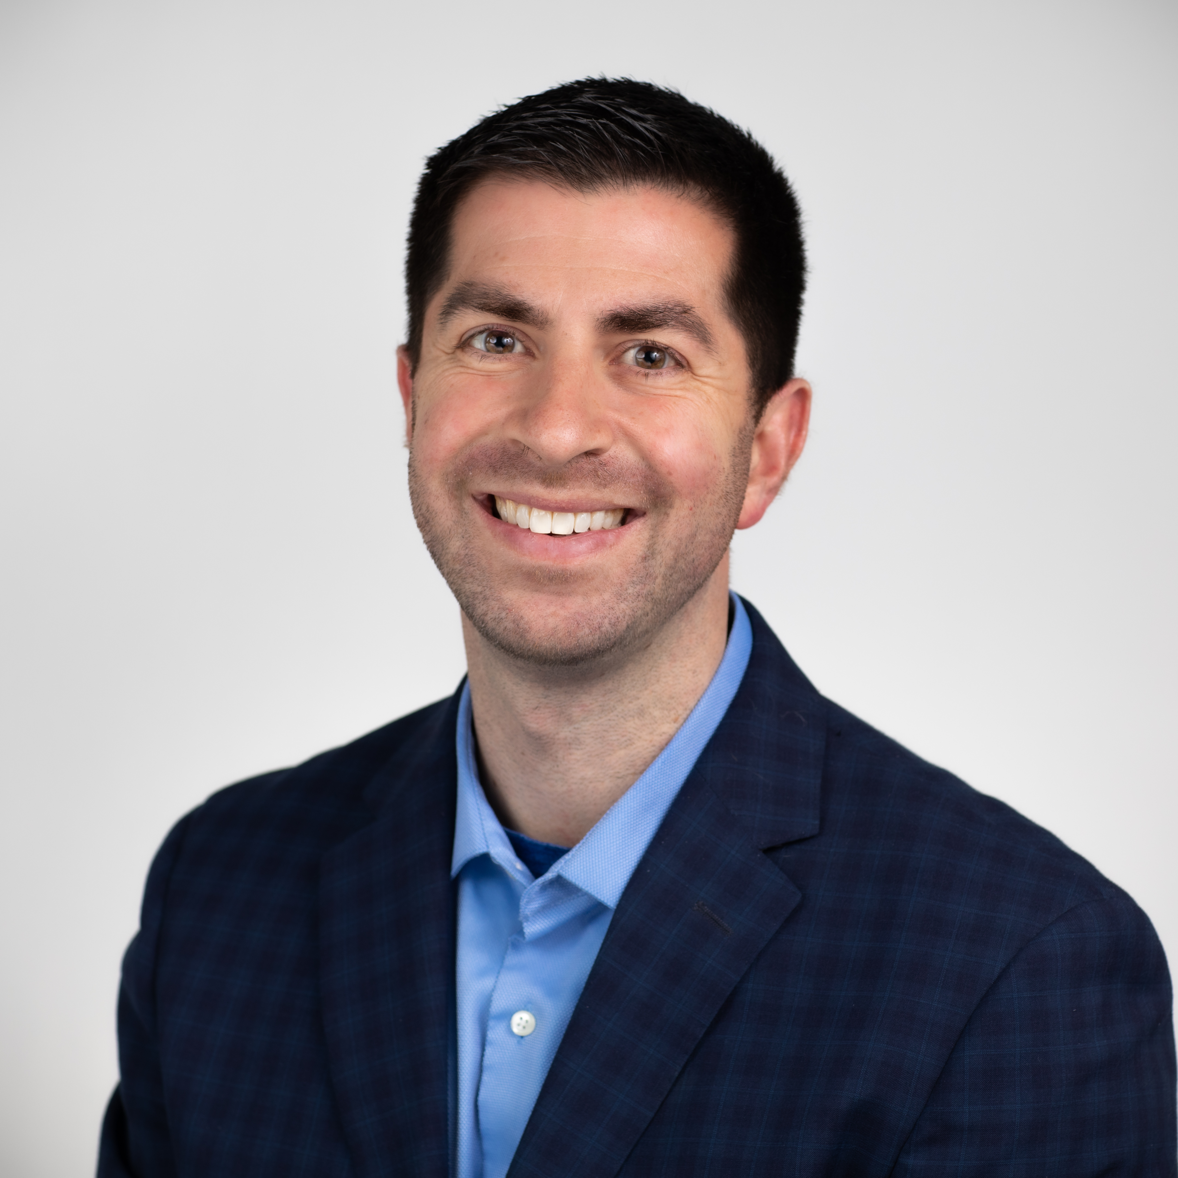
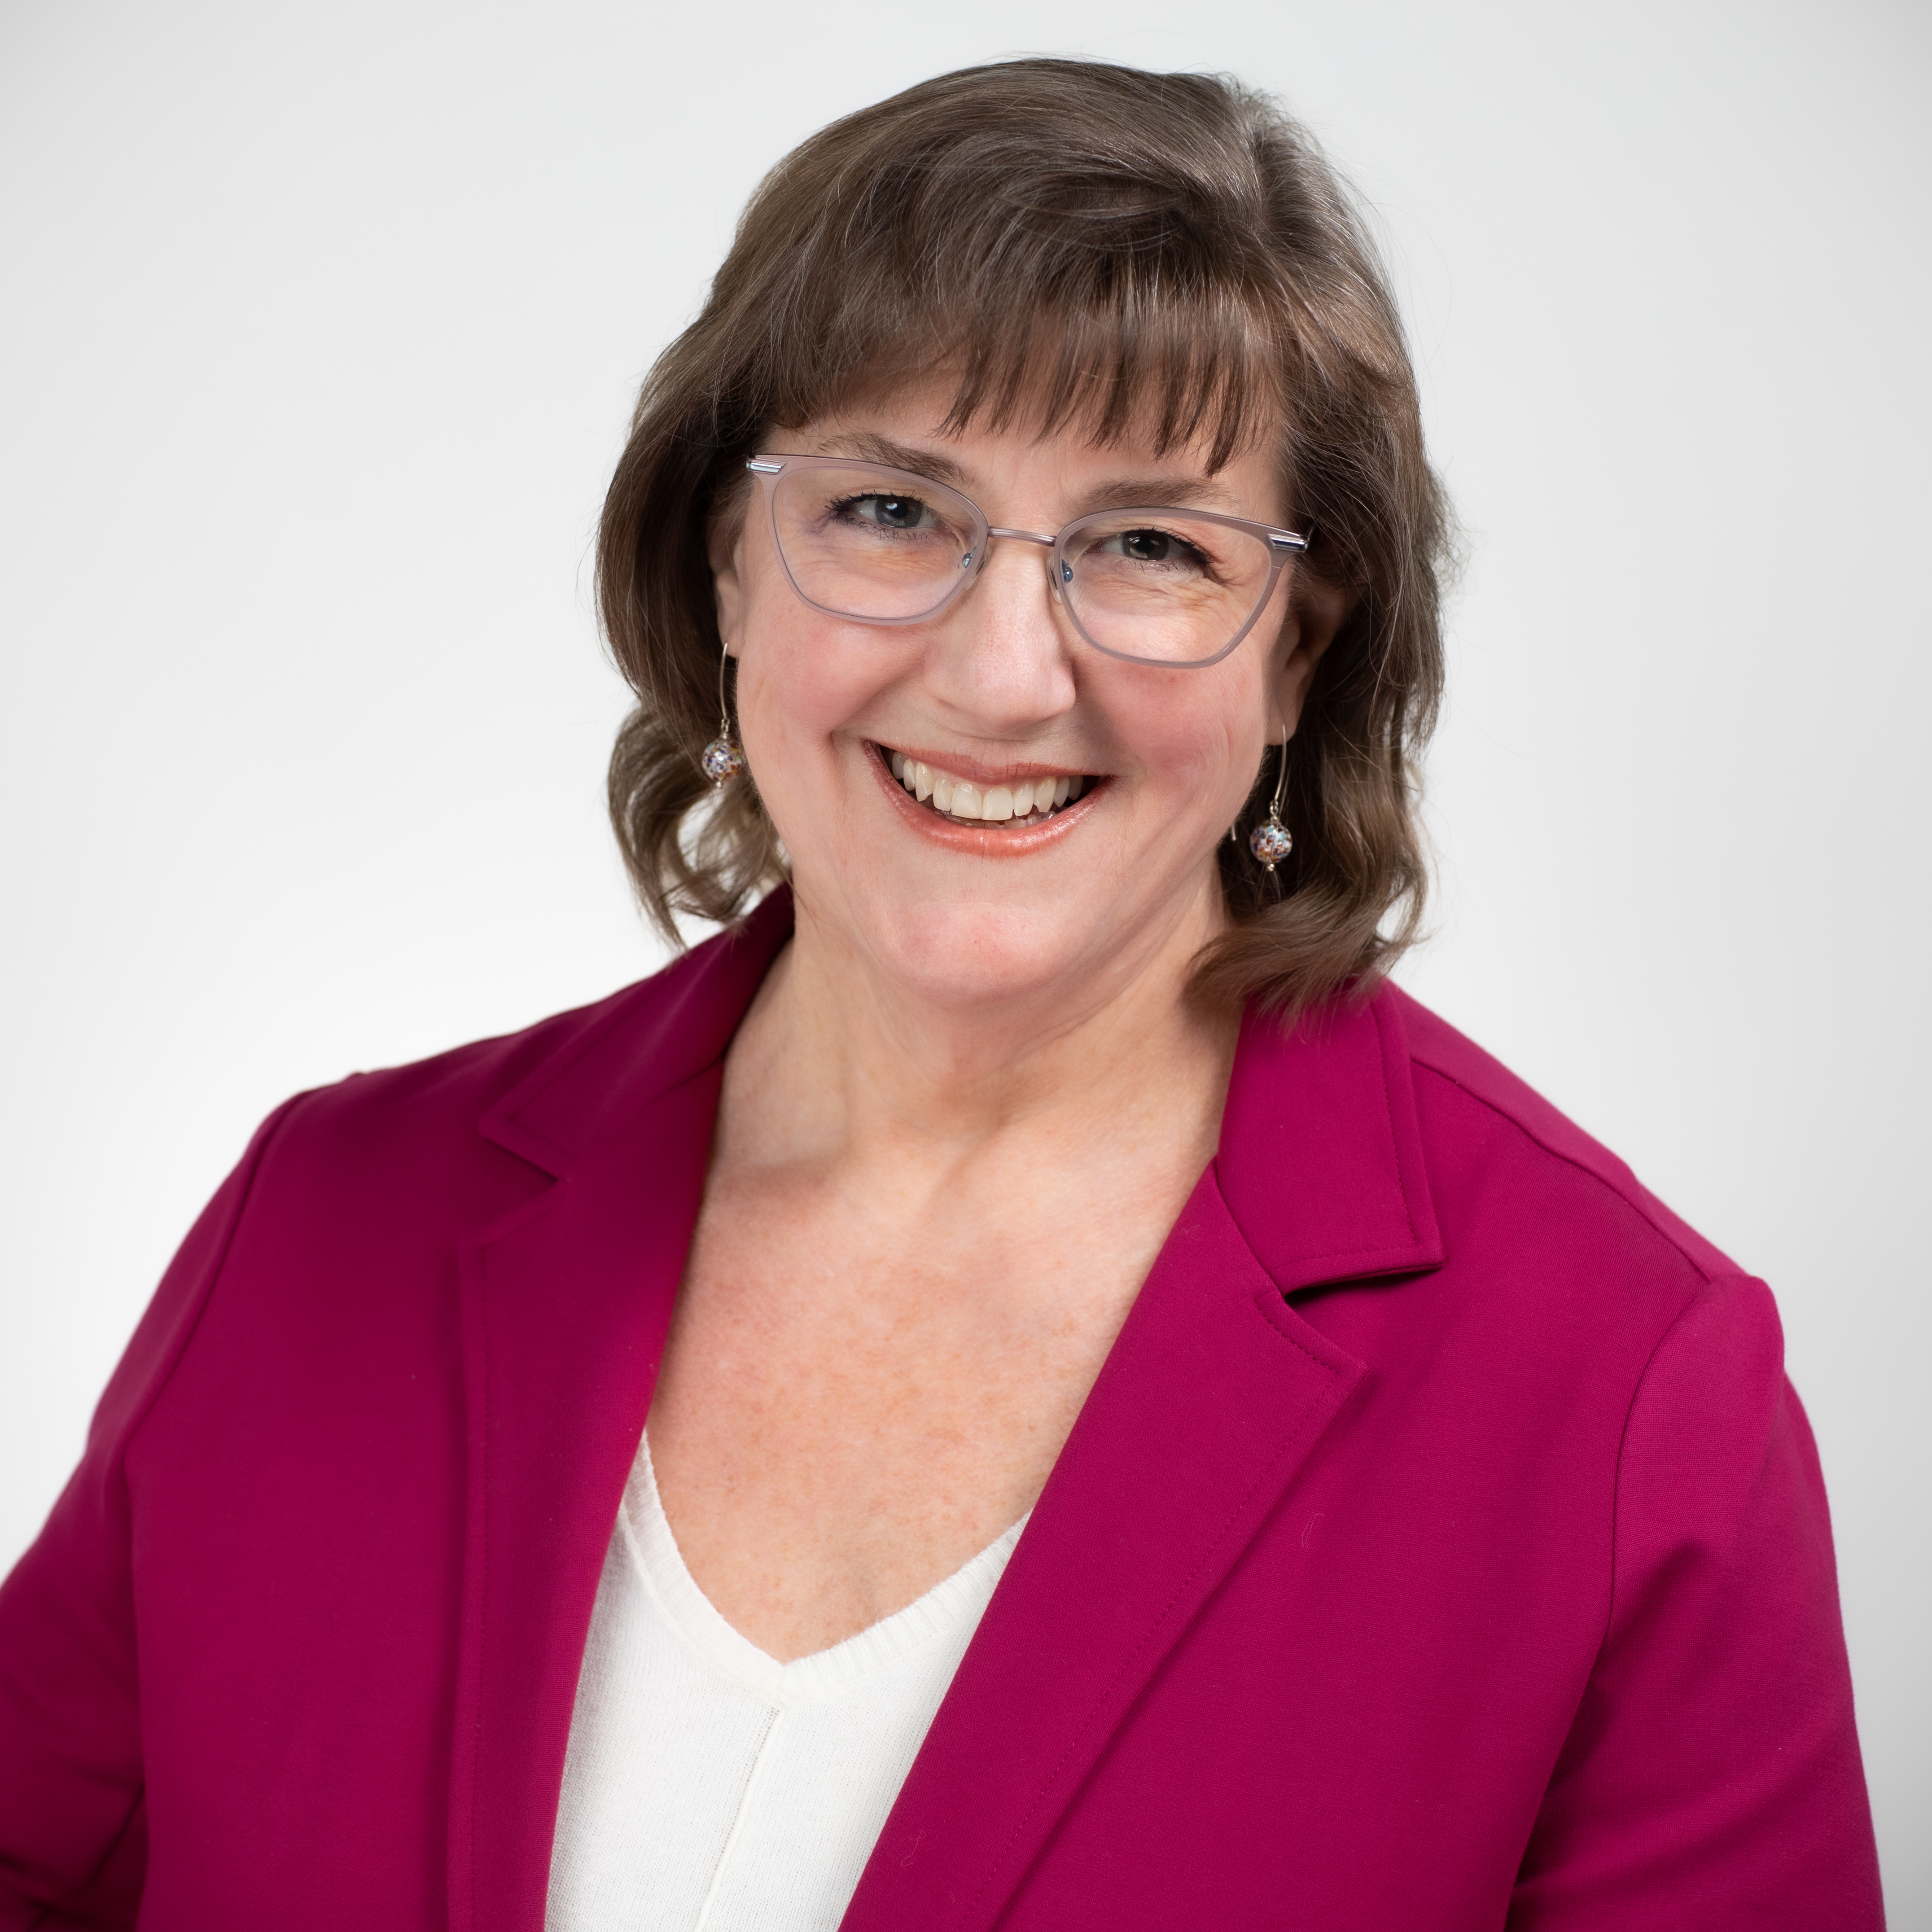

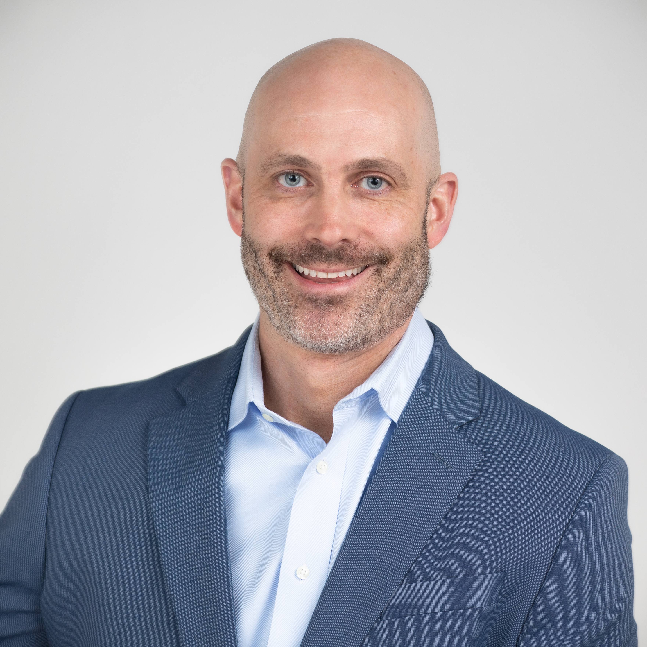
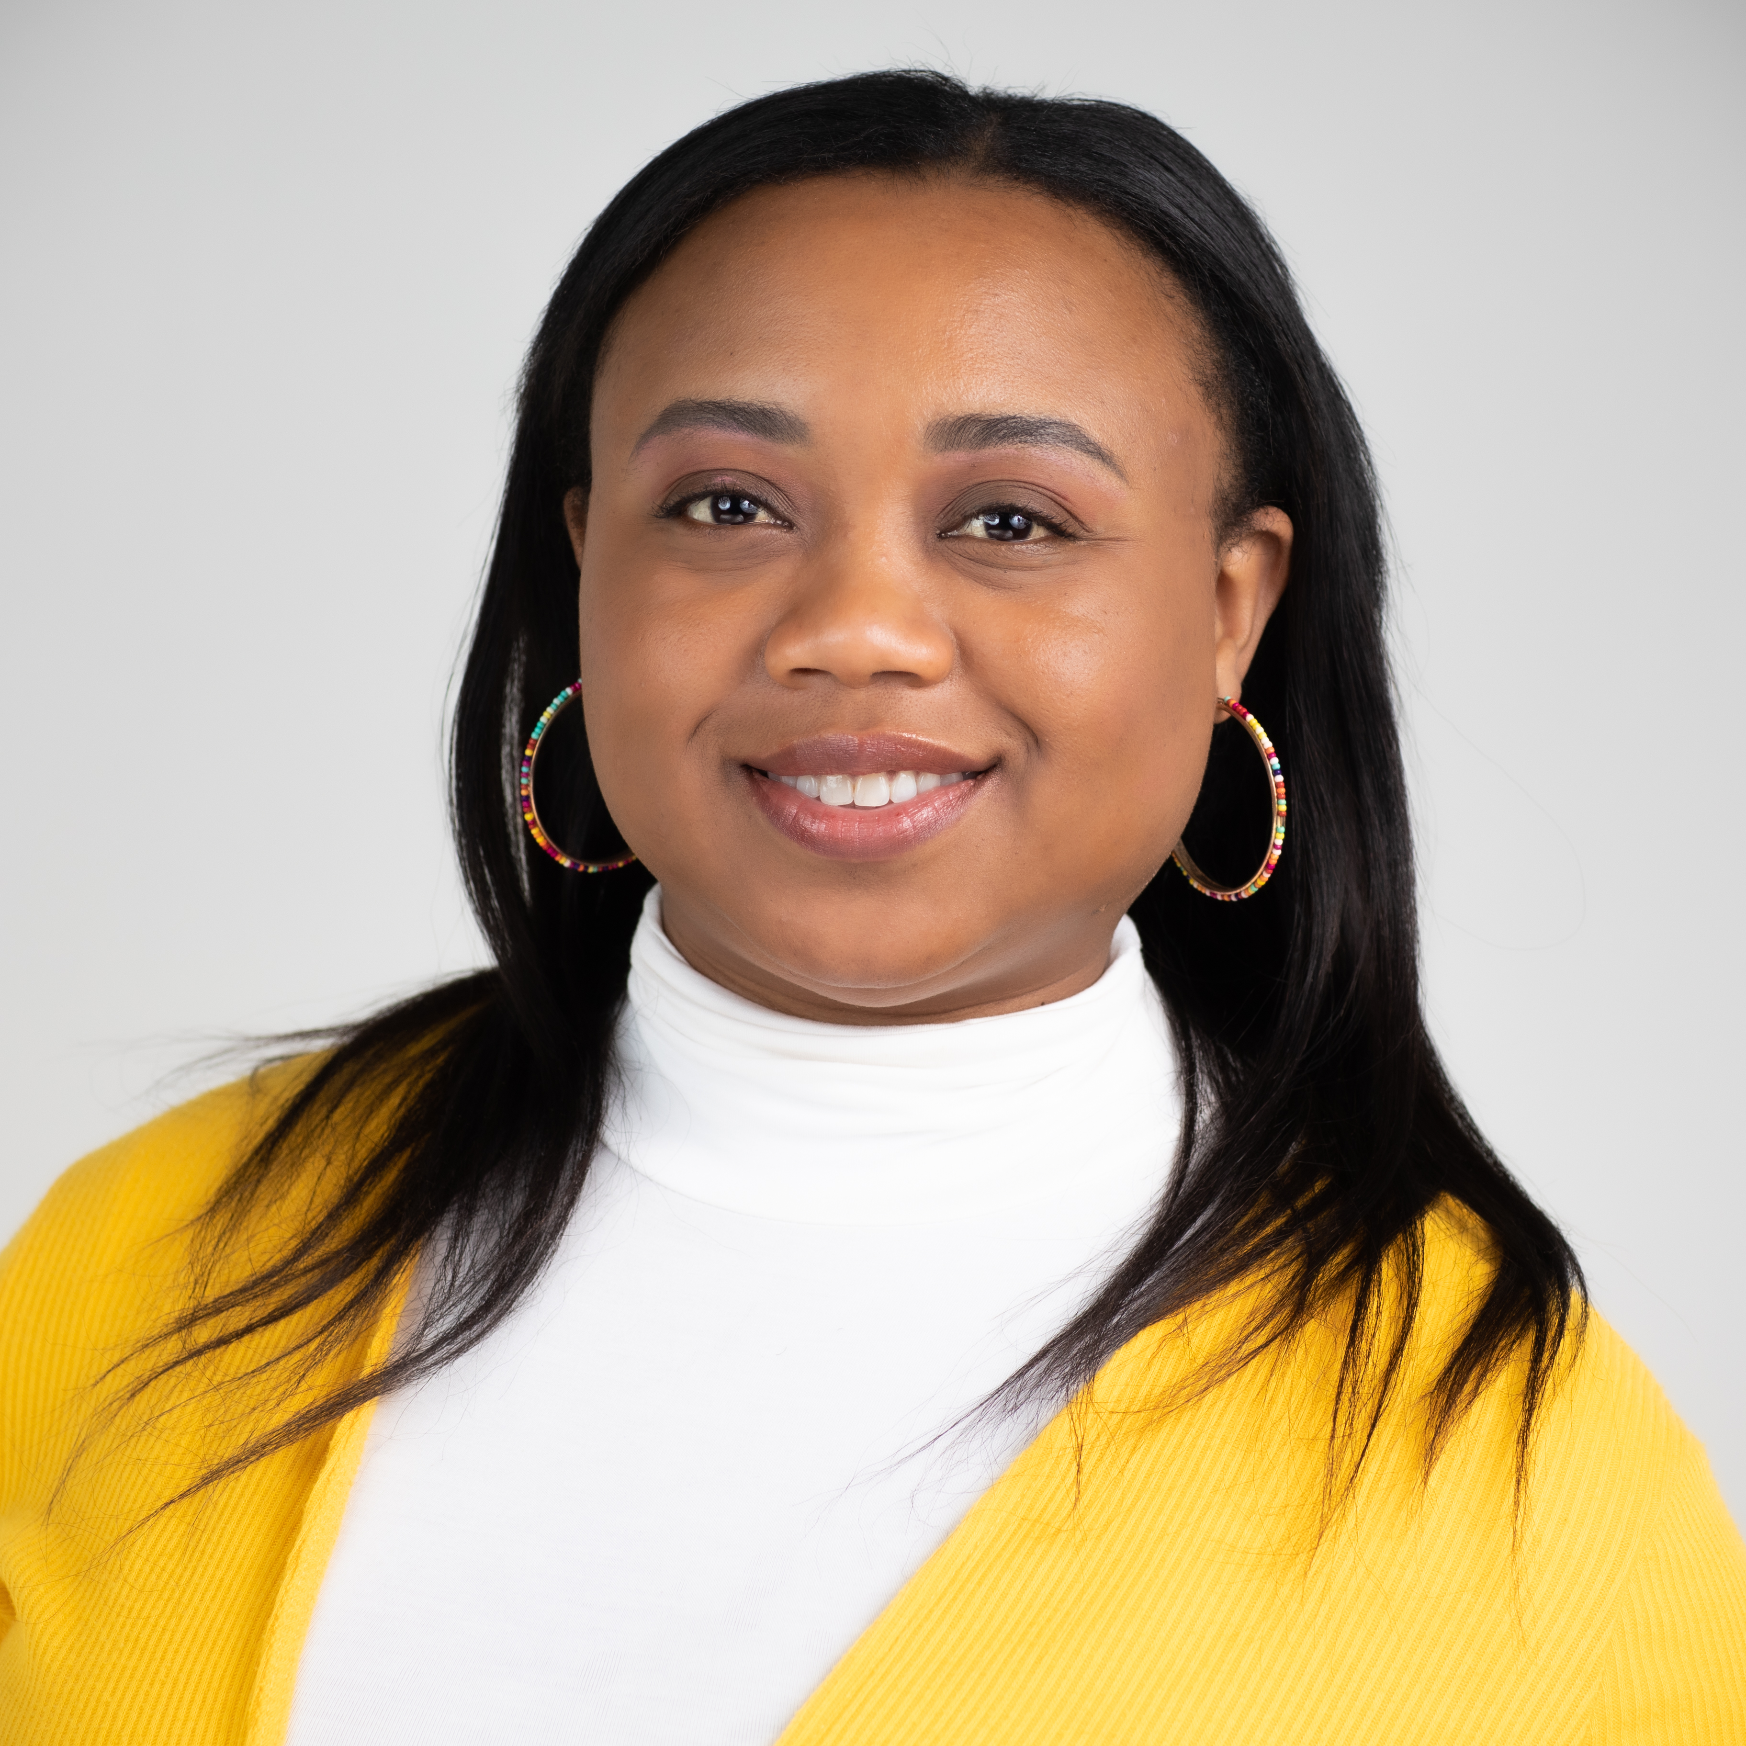
Your Gift Planners
Greg Shamey
  VP, Charitable Giving Services
Cindy Aegerter, CFRE
  Senior Gift Planner
Ben Boline, J.D.
  Senior Gift Planner
Justin Palecek, J.D.,
  Senior Gift Planner
Nikki Johnson
  Associate Gift Planner
Contact us | giftplanner@thrivent.com | 800-365-4172

Slide 25
About Thrivent Charitable Impact & Investing
Thrivent Charitable Impact & Investing® brings hope to the world by empowering people to create the change that matters most to them. We open the joy of generosity to all by making it easy for anyone to give to the causes they cherish. We take a holistic, personalized approach to help our donors create strategic charitable plans, illuminating new paths to personalized impact through visionary models, tailored service and deep expertise. Ignited by our faith, we are passionate about creating positive impact and inspiring lasting change in our communities.

Slide 26
Thank you

